Slide 1
Navigating in UPlan
Budget & Resource Management
Spring 2024

Slide 2
© [2023-2024] “University of California San Francisco (UCSF)”
Ownership of Copyright
The copyright in this material (including without limitation the text, artwork, photographs, and images) are owned by UCSF.
Copyright License
UCSF grants to you a non-exclusive royalty-free revocable license to:
- View this material on a computer
- Store this course in your cache or memory
- Print pages or material from this course for your own personal and non-commercial use.
All rights reserved.
Enforcement of Copyright
UCSF takes the protection of its copyright very seriously. If UCSF discovers that copyrighted materials have been used in contravention of the license above, UCSF may bring legal proceedings against you seeking monetary damages and an injunction to stop you from using the materials.

Slide 3
Contents
Getting Started in UPlan
UPlan Menus and Toolbars
Preferences and MyOrg
Forms and Navigations
Right-click Menu Features
Seeding and Global Assumptions
UPlan Reports

Slide 4
Getting Started in UPlan

Slide 5
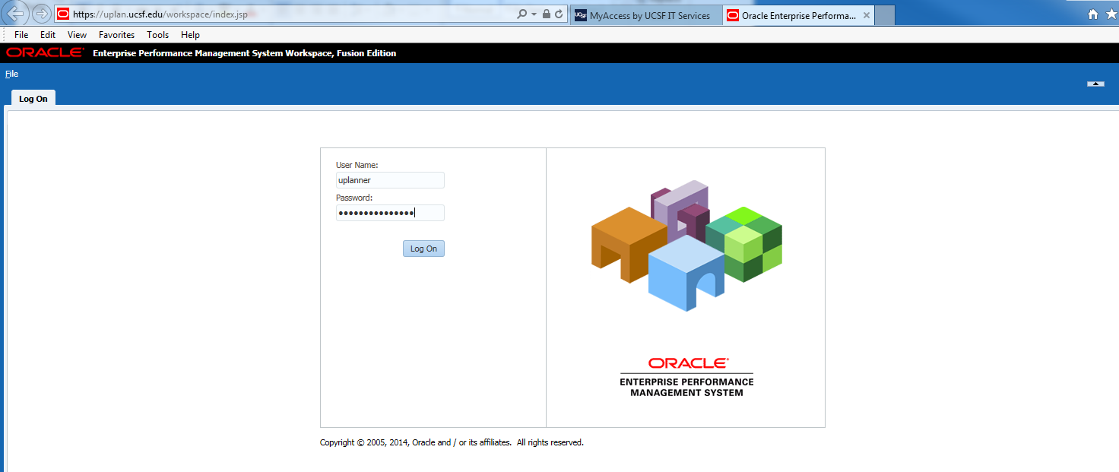
Logging on to UPlan
Log on via MyAccess
Sign in using the same username and password as the you normally use to sign into your computer every day
Format your browsers according to the UPlan Browser Requirements
Note: the name UPlan will not appear on this screen or within the system

Slide 6
Logging Off UPlan
When you have finished working in UPlan, you need to log off
If you do not log off, your session will time out
It is always best to log off of your session when you have completed your work

Slide 7
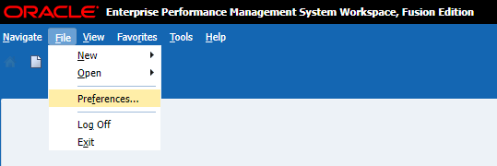
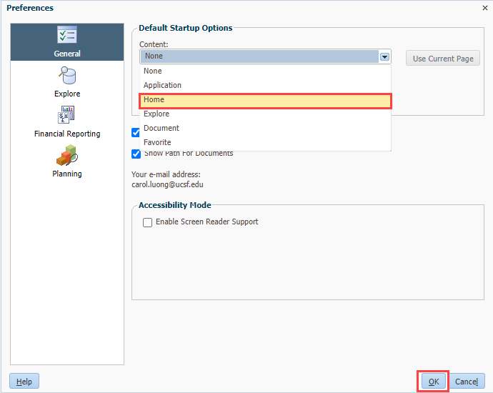
Workspace User Interface Preferences
When you log on to UPlan, the first screen you see will be blank.
To enable the UPlan Workspace HomePage:
Select File > Preferences…
From the General section, under Default Startup Options, select Home and Click OK
Log Off and Log On again to apply your saved preferences. The UPlan Workspace HomePage appears.

Slide 8
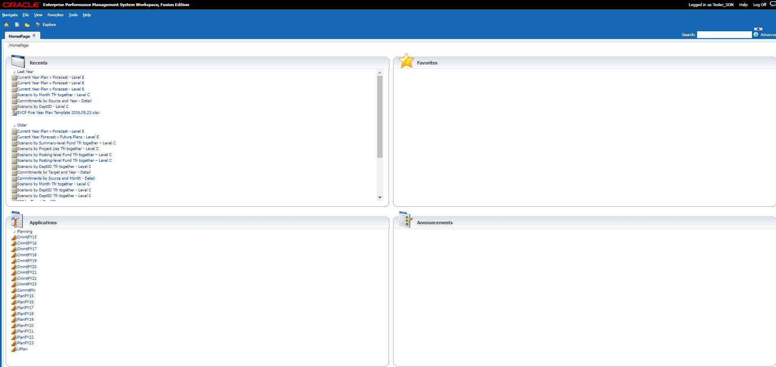
The HomePage is the gateway for accessing the UPlan
Recents show the items you use frequently
Applications direct you to the UPlan applications UCSFPlan and CommtPln
Explore will take you to Hyperion Financial Reports (FR)

Slide 9
To open a UPlan Application, simply click on the link from the HomePage
You can open multiple applications at once, including second instances of the same application
A new tab appears below the masthead when you open an application, form or report
Allows you to have multiple items open at the same time
Allows movement between pages by clicking the appropriate tab heading
A tab can be closed by clicking the Close “x” button on the tab

Slide 10
You have several options for opening UPlan applications
From the HomePage, in the Applications section, click the application link of your choice.
or
From the Menu bar, click File > Open > Applications > Planning, then select the application.
or
From the Menu bar, click Navigate > Applications > Planning, then select the application.

Slide 11
Each application page is divided into two sections
The View Pane displays selections of forms, task lists, and preferences.
The Content Pane displays the corresponding task list or form selected.

Slide 12
“My Task List” provides links to forms and reports
Task Lists are:
An organized collection of Forms
Created and managed by the UPlan Administrators
To select Task List forms from the view pane: click title or icon
Click on the small plus sign to expand a folder
To select Task List forms from the content pane: click Action icon:
When you select a Task List, you will see:
The tasks expanded in the Content Pane
A pie graph depicting the status of tasks
This is an out-of-the-box feature that cannot be removed
Since UPlan is not using system-required due dates, task status is inaccurate and should be disregarded

Slide 13
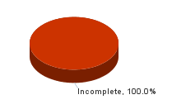
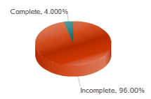
The Task List Status buttons at the bottom of the window are not used
UCSF is not using what Hyperion Planning calls “work flow”
Task List Status information therefore is not meaningful
At the bottom of each form, there is a place to check if the task is complete. DO NOT USE THIS.
It is possible that someone will use this button. This will:
Mark the task complete for all users, regardless of their DeptID or level
Possibly change the appearance of the pie chart in Task List Status
Normally, the pie chart is all red (indicating incomplete)
With button used

Slide 14
UPlan Menus and Toolbars

Slide 15
Menus in the masthead help you perform actions
FILE MENU
Open | Open an application
Save | Save data input to data forms
Print | Print the current data form displayed
Preferences | Set various preferences
Log Off | Log off
Exit | Exit Workspace
TOOLS MENU
Change Password | Change your UPlan password (Do not use)
Export as Spreadsheet | Create an Excel version of the current form, including currently displayed data
EDIT MENU
Open | Open an application
Save | Save data input to data forms
Print | Print the current data form displayed
Preferences | Set various preferences
Log Off | Log off
Exit | Exit Workspace
VIEW MENU
Refresh | Refresh the current view to reflect what is stored in the database
Show / Hide Dimension Names on Page | Display (or hide) names of dimensions in the Page Filter area.
Instructions | Show description of how to use the current form
View Masthead | Hide masthead
Notes:
intuitive

Slide 16
The UPlan toolbar provides several options for navigating within Workspace
Some icons are available throughout UPlan. These are circled in orange.
Others toolbar buttons become available as data forms open. When you open a Form, the Toolbar displays additional icons. These are highlighted in red.

Slide 17
Toolbar Icon Functionality
Icon | Description
Home | Opens the HomePage tab
Explore | Opens the Explore tab for accessing Reports
Save | Saves input on data forms
Refresh | Refreshes the data form with data stored in the database
Print | Prints the current data form displayed
Adjust | Increases or decreases values by a percentage or a value
Grid Spread | Spreads data across dimensions on the data form
Cell Text | Adds comments to a specific cell at any level in data forms
Lock/Unlock | Locks or unlocks cells when spreading data
Supporting Detail | Adds detail that aggregates the cell value in data forms
Cut | Cuts a data value from a cell on a data form
Copy | Copy data values on a data form
Paste | Paste data values into other cells on a data form

Slide 18
Preferences and MyOrg

Slide 19
Preferences may be set to indicate how certain items display within an application
Use Preferences to set your MyOrg DeptID
Found on User Variable tab in Preferences
MyOrg is:
A DeptID, at any level of the tree, that is used to identify or limit the number of departments displayed on a form
A pre-designed filter that allows you to focus your efforts on the DeptIDs you want to plan
Required to be set for both Employee Planning and Commitment Tracking modules
Planners should select a MyOrg that represents the portion of the DeptID tree for which they are responsible

Slide 20
Forms and Navigation

Slide 21
“Forms” are the UPlan screens for entering or retrieving data
Forms are predefined templates
Planners can modify data only; not the design of the forms
Forms are similar to Excel spreadsheets
Data appear in rows and columns
Data entry is made in individual cells
Planners can use edit, copy, and paste keyboard or mouse functions
Note: when accessing forms via the web, planners cannot enter formulas into cells
Notes:
Cannot modify the actual design of the form

Slide 22
Within each form, some or all of these common steps may be performed
View data
Enter or edit data
Add rows
Expand columns
Change page filters
Navigate from a landing page to a data entry form
Save changes to data

Slide 23
Forms can be accessed in three ways
From My Task List View Pane
From My Task List Content Pane (use action icon )
By using the right-click menu on a landing page (in some cases)

Slide 24
UPlan contains three types of forms
Landing Pages
Provide a summary list of information
Do not allow data entry
May be used to access Data Entry Forms, typically as a jumping off point
Data Entry Forms
Form Reports
Do not allow data entry
May be used to access Data Entry Forms
Notes:
Landing Page:
Summary listing of information; Not for entering data
Used to jump to related Data Entry Form
In Commitment Tracking and Employee Planning modules
Data Entry Form: allows data entry (when in a planning intersection)
Form Reports: in General Planning and Employee Planning

Slide 25
Forms in UPlan
Data Entry & Landing Page Forms you will use in UPlan include:
*Note: These forms are Landing Pages
Module | Form(s)
General Planning | Revenue and Expense – Level C (or E) Tuition and Fee Revenue Calculator Global Assumptions
Employee Planning | Existing Employees* To-be-Hired* Employee Search*
Commitment Tracking | Manage Commitments* Commitments Search*
Notes:
Landing pages: show you a summary listing and enable you to jump to other detailed Data Entry Forms.
Not listing read only form reports on this slide

Slide 26
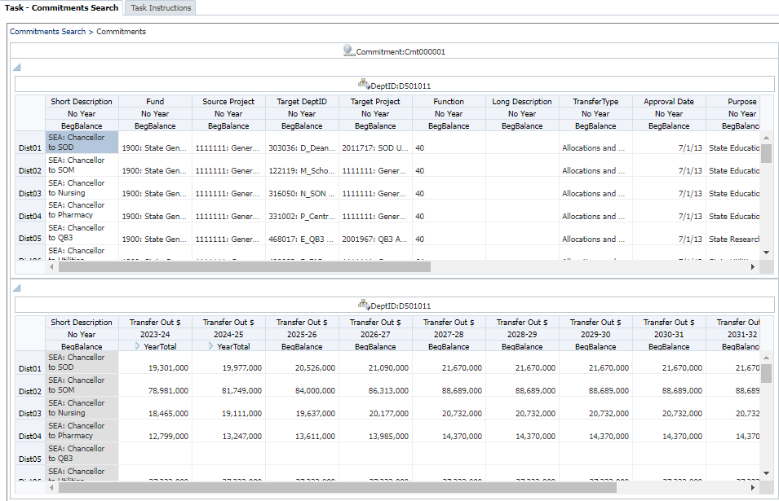
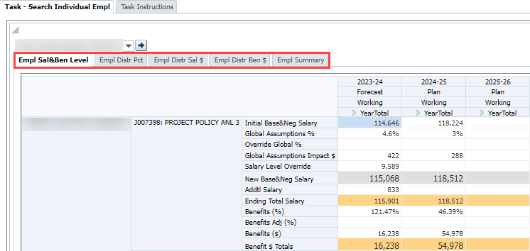
Composite Forms include multiple tabs or panes to improve navigation
Multiple forms combined on one screen view
Two main types of composite forms in UPlan:
Multiple Panes:
Multiple Tabs:
TOP
BOTTOM

Slide 27
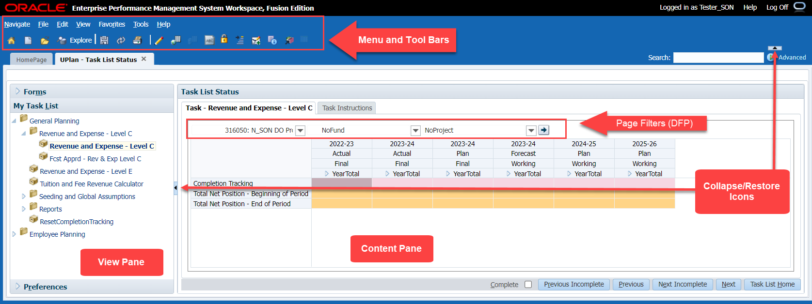
Parts of a Form
Notes:
Content pane displays the form- expand the content pane to display more of the form on your screen
Page filters change the DFP (or other dimensions) for which you are planning or forecasting with the form.

Slide 28
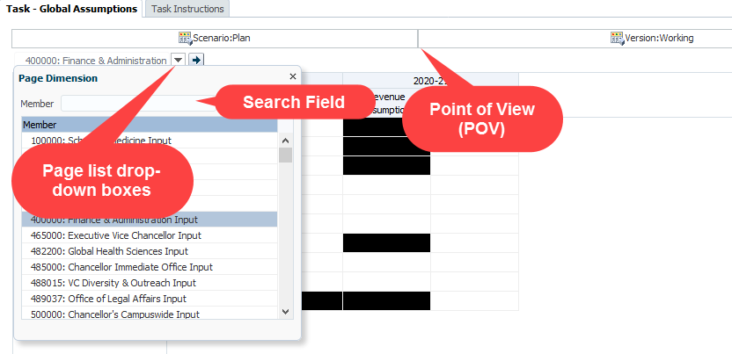
Point of View and Page Filters determine what data appears on your form
Point of View (POV) contains hard-coded dimensions for the form (except MyOrg is not hard-coded)
Page Filters are dimensions that can be changed
Note: Some forms display one or the other, or both
Notes:
Point of View (POV) contains the dimensions that are hard-coded by the UPlan Administrator on the Data Entry Form
On some forms, the POV also identifies the MyOrg value
In some cases, these are hidden; in others they appear at the top of the form
Page Filters are dimensions that can be changed
For each Page Filter dimension, a drop-down list can be used to select another member for that dimension

Slide 29
Selecting Page Filters
Mouse over the Page Filter arrow button to open the Member Selection tool
Type in the search box or scroll through the Member list
Click on your selection
Either change another Page Filter value or Press the Go icon to refresh your Page Filter selection:
Note: Make sure to check the Page Filter selections each time you begin working on a form to ensure you are viewing/entering data for the correct dimension members.
Notes:
Can’t type right into the Page filter box, need to drop down the pick list

Slide 30
An intersection is a specific combination of dimension members
Intersections are defined by:
Point of View
Page Filters
Specific column and row
Data can be entered in valid planning intersections
On writable Data Entry Forms
Where cells are white (in most cases)
Notes:
Rows are not the entire row, they are the beige colored dimensions that you will see on any given form

Slide 31
Cell shading helps users differentiate information
Pink cells highlight the Completion Tracking row
Yellow cells indicate unsaved changes
White cells indicate intersections where data can be entered
Orange cells indicate read-only data, typically subtotals
Gray cells indicate read-only intersections of data, typically fed from elsewhere; they may also be a calculation on some forms
Blue cells indicate supporting detail
01/12/2024
Notes:
Formatting- Cell Shading
You’ll notice different colors on the form. The cells in which you can enter data are white. Once you’ve entered data, they will turn bright yellow, meaning you have to save the form to send your new data to the database. The orange rows represent subtotals. Gray cells indicate that data are pulled from another source and are therefore also not writable. In some forms, gray cells may also indicate the result of a calculation. Blue cells indicate there is supporting detail that generated the cell value. Finally, pinks cells indicate the completion tracking row on the general planning revenue and expense form.
Not pictured here:
Blue triangle in the right hand corner of a cell indicates comments or a document attached to a cell
Black cell (on global assumptions): indicates no data entry (not literally blocked, but don’t enter)

Slide 32
Columns will hold one or more dimensions
In some cases, columns can be expanded or collapsed
E.g., Year Total -> Monthly

Slide 33
Rows will also hold some number of dimensions
Depending on the form, rows may hold:
Accounts
DFP combinations
Commitments
Employees
Generally, rows with no data will be suppressed on the form
Planners can add rows to a form using a right-click menu option
Notes:
Rows are not the entire row, they are the beige colored dimensions that you will see on any given form

Slide 34
Runtime Prompts are dialog boxes that appear, requiring additional information
They may appear at various times, such as when:
adding accounts to the Revenue & Expense form
adding a new To-Be-Hired (TBH) in Employee Planning
In most cases, planners can use a look-up icon to select a member:

Slide 35
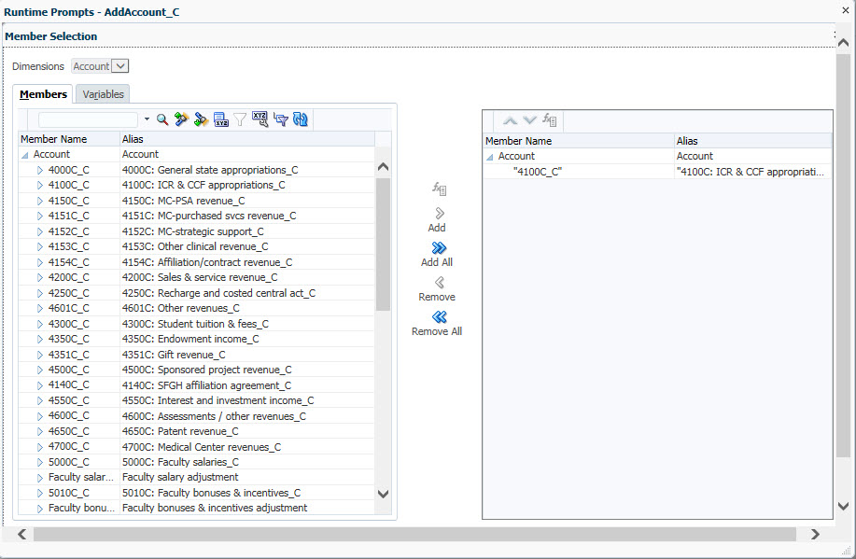
The Member Selection dialog box is a frequently-used tool
The buttons in the search box aid in finding desired members:
Highlight column members on the left and use the buttons in the middle to add or delete your selection(s):
 | Filtered Search | Show a list of all members including this text
 | Search Up | Advance to the next member containing this text
 | Search Down | Go back to the last member containing this text

Slide 36
Data can be entered into writable intersections (white cells)
Options for data entry:
Typing values directly
Cutting and pasting
Forms in UPlan use many of the Excel shortcut keys
Shortcut | Action
Enter | Enter the value and move the cursor to the field in the next row
Tab | Enter the value and move the cursor to the field in the next column
Shift + Tab | Enter the value and move the cursor to the field in the previous column
Esc | Cancel the value and restore the previous value
Ctrl + C | Copy the values in the field or range of fields
Ctrl + X | Cut the selected field or range of fields
Ctrl + V | Paste content from the clipboard
Ctrl + S | Save data

Slide 37
To enter data, click on the cell until an inner white box appears
Click or double click cell until it shows an inner white box
Highlight or delete existing data
Type a value
If value is a percentage, use one of these methods
Include the percent sign: 100% or 50%
Use a decimal equivalent: 1.0 or .50

Slide 38
Data entered in the YearTotal column will spread to individual months
A value entered in a month stays in that month and updates the YearTotal
A value entered in YearTotal spreads across the months
Spreading will follow existing proportional distribution pattern of values in cells
Only open (non-actualized) months will update
To clear the spreading pattern, use Grid Spread on the right-click menu

Slide 39
Save your data early and often
When using web forms, saving submits your data to the UPlan database
During save, form totals are recalculated to reflect the new data for members that are calculated dynamically
Three options: Use Ctrl + S, File > Save, or the Save icon
Refresh data allows you to discard any unwanted, unsaved data changes (a warning appears)
Use View > Refresh or the Refresh icon
Refresh may also clear up temporary issues (such as Page filters not displaying)
Note: Navigating from the one form to another form without saving will result in the loss of unsaved data
save
refresh

Slide 40
Data Precision and Rounding
Data for forecasts and plans need not be exact
Data values on forms are rounded to the dollar
Monthly values may not sum perfectly to year total values

Slide 41
Exporting Forms to Excel Spreadsheets
UPlan forms can only be edited directly in the UPlan workspace
However, forms can be exported to spreadsheets easily
Landing Page Forms
Data Entry Forms
Read-only Form Reports
Composite Forms only export the form currently visible
To export all parts of a composite form, you need to export each one individually
Select Tools > Export as Spreadsheet

Slide 42
Other Tips and Tricks
Desired Result | How to Perform
Widen columns in a form | Move cursor between columns and click and drag to desired width
Change the magnification of the screen display | Use your browser’s view menu or keyboard shortcuts to zoom in or out
Choose how to display members in Member Selection dialog boxes | Click the Display Property Icon and choose to display member name, alias, or both
Show dimension names for Page Filters on a form | Select View > Show Dimension Names on Page
Have numbers appear with commas | In Preferences > Display Options, set thousands display to Comma

Slide 43
Right-click Menu Features

Slide 44
Many actions in UPlan are achieved via right-click menus
These features include:
Edit: Copy, Cut, Paste, Clear
Add a row (such as an Account)
Remove a row (such as an Account)
Adjust Data
For certain actions (such as adding a row), you must right-click on the right-most row header

Slide 45
The Adjust Data option enables value or percentage changes to data
Highlight cell(s) and choose one of these methods:
Right click and choose Adjust > Adjust Data
Use the Edit > Adjust menu option
Click on the Adjust icon
Select By Value or By Percentage and Increase or Decrease
Then type a whole number
Note: It is possible to adjust multiple cells at one time
Cells must be contiguous
Cells must be at same level and dimension (such as Months)

Slide 46
Spreading distributes data from YearTotal to individual months
Spreading occurs based on the following logic:
If no data are in the open months, the new YearTotal value will spread evenly
If data exist in any or all of the open months, the new YearTotal value will spread proportionally
If some open months are locked or final (such as for closed months of the Forecast), the data will spread based only on the available months
Whenever you make changes to data, whether using spreading, grid spreading, or adjusting, gray, read-only cells will be ignored.

Slide 47
Grid Spread is similar to spreading, but allows more control
Grid Spread Option | Result
Proportional spread | Takes the updated value and distributes proportionally based on current value in each month
Evenly split | Takes the updated value and divides it evenly, regardless of current value in each month
Fill | Takes the updated value and copies it to each month

Slide 48
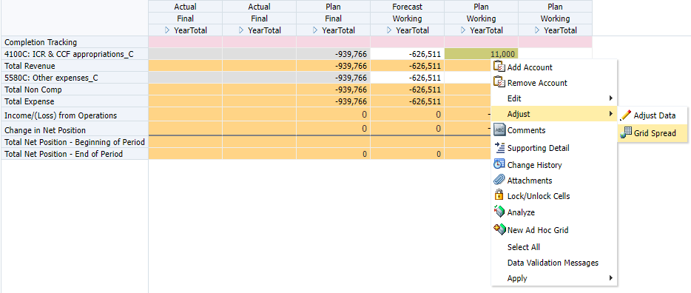
Grid Spread is a sub-menu option under the Adjust right-click selection
Notes:
Note: More detailed step-by-step instructions in manual

Slide 49
At various times, planners will want to add a Row to the data entry form
Right-click on a row and select the Add option
Planner must click on the right-most row header on the form
Options will vary depending on the data entry form
A Runtime Prompt dialog box opens
Type your selection, or click on the Member Selection icon
The Member Selection dialog box opens
Search for and highlight your selection
Choose Add, click OK and Launch
Notes:
Accounts with no data are suppressed in the form. As a result, sometimes, you will not see revenue or expense accounts for which you want to enter data. In this case, you may need to add accounts.
After you add accounts, they will display for this DFP combination in future sessions, whether they have data or not. If you want to remove a blank row you had added, you can select Remove Account. See the Removing Accounts section.

Slide 50
In some cases, it is also possible to remove a row
Move your mouse to a row you want to remove
Right-click and select the Remove option
A warning window opens, click OK
The selected row no longer displays on the form
Note: Planners can only remove one row at a time
Notes:
As long as there is no data in them, you can remove these accounts.
You can only remove one account at a time, even if you highlight multiple blank rows.
Once you remove the account, it will not reappear for this DFP combination in this session or future sessions (unless there is data).

Slide 51
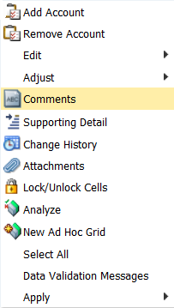
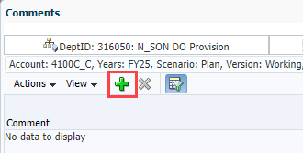
Cell Comments allow planners to add or edit background information
Right Click on a cell and select Comments
To add a comment, select Actions >
Add or click the green plus sign
Type a comment, using formatting if desired
Cells with comments are indicated with a
blue triangle in the upper right corner of the cell

Slide 52
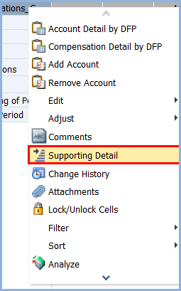
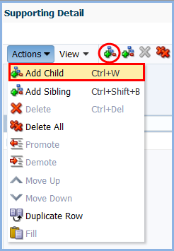
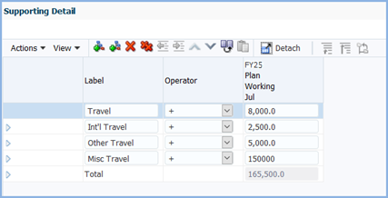
Supporting Detail allows users to document how a value is calculated
Useful when specific factors/equations/drivers determine a cell’s value
Highlight a desired cell and right-click
Select Action > Add Child from the Supporting Detail Dialogue Box or click the Add Child Button
Add Labels, Data, and Operators and click Save
1.
2.
3.

Slide 53
Locking prevents data in those cells from being over-written
Locking cells may be useful during:
Spreading
Adjusting
Grid spreading
Locked cells appear light brown
Unlocking locked cells
Can be manually done
Happens automatically on save
Lock and unlock a cell using the right-click menu

Slide 54
If desired, you can hide rows with no data
By default, most forms in UPlan show only rows with data in them
Hiding rows allows you to remove all rows with no data during the current session
To hide rows in forms:
Right click on a row heading in a form and select Filter > Hide Rows with zeros and no data
The form refreshes, showing only rows with data
To restore all rows in this session, right click and select Filter > Show Rows with zeros and no data

Slide 55
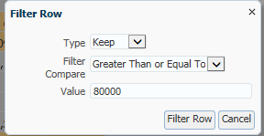
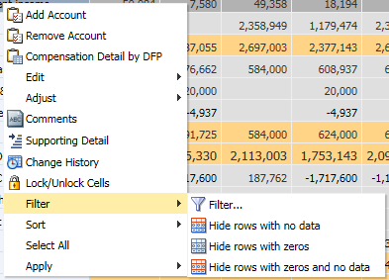
Forms can be filtered based on rows or columns
Filtering allows you to keep or exclude only rows or columns that match certain criteria
Filtering can be accessed through the Right-Click Menu

Slide 56
Filtering Rows or Columns in Forms (cont’d)
Filtering criteria in the dialogue box include:
To restore the data, right-click and select Filter > Cancel Filter
Criteria | Function
Type | Select Keep to retain items matching your selection or Exclude to remove items matching your selection
Filter Compare | Select one of the options in the dropdown box such as Equals or Greater Than
Value | Type an amount or text information with which to compare the rows (or columns); if you are using text, the Filter Compare selection must be Equals or Not Equals

Slide 57
UPlan Reports

Slide 58
UPlan Reporting
UPlan contains two types of reports
Form Reports
Hyperion FR Reports
Help to identify areas in planning that may need attention
Summarize data to help identify areas where corrections may be needed
MyReports
Management that will include both financial and planning information
Provides drill-down and drill-through functionality
Notes:
UPlan provides several reports to support planning activities.
Diagnostic reports help to identify areas in planning that may need attention. For example, the Completion Tracking report helps identify DFP combinations that might need additional planning.
Planning outcome reports summarize data to help identify areas where corrections may be needed. For example, the Plan Net Position (formerly Plan Deficit) report show the Net Position – End of Period value for each DFP, enabling planners to quickly identify DFP combinations with ending deficits. In addition, UPlan includes reports of commitment data, which will not be transferred to MyReports.
UPlan does not directly provide management reports. These are generated from MyReports.
Where’s My Report?
In addition to Form reports (found in UCSFPlan Task Lists) and Hyperion Reports (found in Explore), there are some reports you will run from MyReports.
Once plans and forecasts developing in UPlan have been made final, they will be sent to the data warehouse. At that point, analysts can go to the MyReports tool to run a variety of management reports that will compare UPlan plans and forecasts with actuals from the PeopleSoft General Ledger. These management reports provide a great deal of drill-down and drill-through functionality, allowing analysts to retrieve the information they need. For more information about MyReports, visit the Controller’s Office website.
We will also talk about the two types of reports within UPlan: Form Reports and Hyperion Reports. You will learn the differences in how they are accessed and how to change the data you are viewing.

Slide 59
UPlan Form Reports are accessible from the Task List
Read-only
Easy-to-use
Use Page Filters to change the data displayed
Export to Excel using the Tools menu
In some cases, form reports will include right-click options allowing navigation to data entry forms
Form reports are typically found in a reports folder
General Planning > Reports
Employee Planning > Reports
Commitment Tracking > Commitment Reports
Notes:
The first type of report is called Form Reports. These are essentially forms that are read-only.
Form reports provide current information from UPlan in an easy-to-use format. You can make changes to Page Filters, print the reports, or export them to Excel.
You can access Form Reports from My Task List:
General Planning Form Reports are found in General Planning task list folder
Employee Planning Form Reports are found in the Employee Planning task list folder
Form Reports are similar to Landing Page forms. Unlike Landing Pages, you will not use the right-click menu to perform any activities.

Slide 60
Hyperion Financial Reports (FR) are accessed using the Explore button
Dialog boxes for selecting report filters are similar to those used for member selection on forms
Export to Excel using File > Export
Notes:
The second type of report in UPlan is called Hyperion Reports. You access these reports by clicking Explore. Explore brings up the Reporting Repository, which holds folders of dedicated reports.
You can also export them to Microsoft Excel.
In Hyperion Reports, you will find reports for the Commitment Tracking module. They reside in a folder called Commitment Reports.

Slide 61
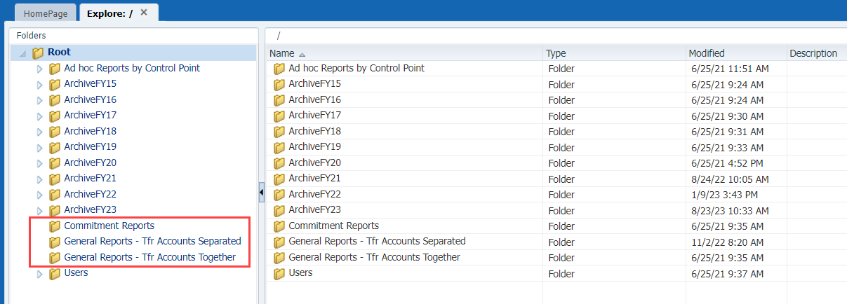
To run a Hyperion FR Reports, click Explore
Select one of the folders to find Hyperion Reports for Commitment Tracking or General Planning

Slide 62
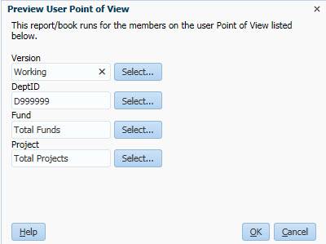
Running Hyperion FR Reports (cont.)
Select a report you want to run and open it in HTML Preview
Use the Preview User Point of View to select dimension members you want to run the report
You can also select POV members on the report
Once the report is open, you can:
Scroll through the report to preview
it in HTML
Export the file to Microsoft Office
using File > Export and choose
Excel, Word or PowerPoint
Change to PDF preview and print
Notes:
From anywhere in UPlan, click “Explore” to open the reports repository.
Select one of the folders to find Hyperion Reports for Commitment Tracking or General Planning.
Select a report you want to run and open it in HTML Preview:
Double click to open in default preview mode
Right click and select Open In > HTML Preview
Select File > Open In > HTML Preview
The Preview User Point of View dialog box appears, displaying appropriate choices based on the report you selected.
For each dimensions member in the POV that you want to change, you can highlight the current text and type over it with the desired member if you know it exactly, or click the Select… button to find and select a member (See the Selecting POV Members section for details.)
Note: If you are typing a DeptID, you must precede the ID with the letter D. For example, type D330000 (not 33000)
After you have made all your POV changes on the Preview User Point of View dialog box, click OK.
The report appears in HTML.
Here are some options:
Scroll through the report to preview it in HTML
Export the file to Microsoft office using File > Export and choose Excel, Word or PowerPoint
Change to PDF preview and print: Select File > Open In > PDF Preview and use the Print icon at the bottom of the screen
When you are finished, click the X on the tab to close the report.

Slide 63
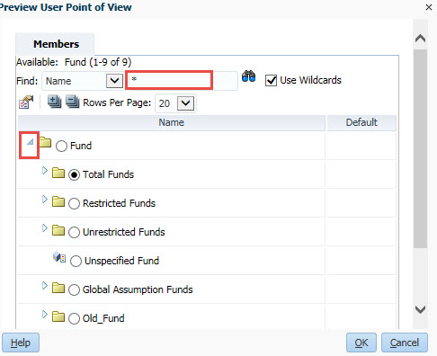
Selecting POV Members
From the Preview User Point of View, you can type or look up and select dimension members
Expand members in the hierarchy and manually find and select the dimension member of your choice
Alternatively, search for a member by name or description by using the Find drop down list to choose Name or Description, then type in the box and click the binocular icon to search
Notes:
When working with Hyperion Reports, you may want to change one or more Point of View dimension members.
You can do this before running the report from Preview Point of View (if you have turned on this option in Preferences) or after the report is on screen.
To select POV members:
From within Explore, open a report.
If the Preview User Point of View dialog box appears, to select a POV member for a dimension, click the Select… button
If the report preview comes up immediately, click a dimension in the POV at the top of the report
The Preview User Point of View – Members dialog box appears, listing the hierarchy of members for the dimension you selected.
You can expand members in the hierarchy and manually find and select the dimension member of your choice. Alternatively, you can search for a member. To search for a member by name or description, you can use the Find drop down list to choose Name or Description, then type in the box and click the binocular icon to search.
Note: To find a DeptID Name, you will need to include the letter D in your search, such as D33*.
The results appear. You may get a message if there are more than 50 choices matching your search. If so, you may need to refine your search criteria.

Slide 64
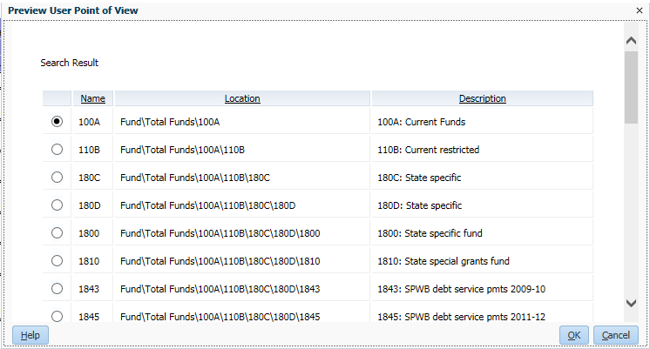
Selecting POV Members (cont.)
The results appear. You may get a message if there are more than 50 choices matching your search. If so, you may need to refine your search criteria.
Notes:
Select the desired member and click OK two times.
Your selection appears as the member for this dimension.

Slide 65
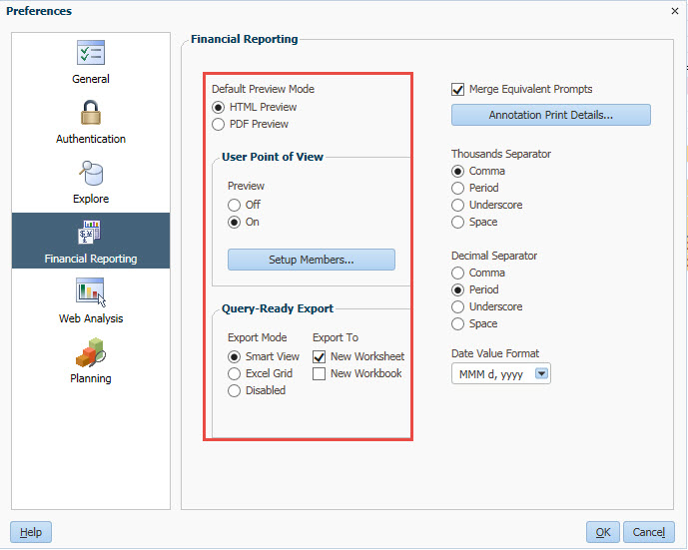
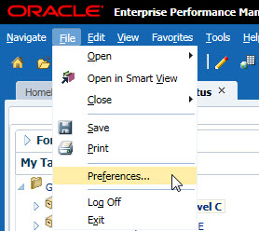
Setting Preferences for Hyperion FR Reports
From anywhere in UPlan, select File > Preferences
Select Financial Reporting from the left side bar.
Set your Default preview mode to HTML Preview
Under User Point of View, set Preview to On

Slide 66
Review Quiz!
1. True or False:
MyOrg is a pre-designed filter that allows you to focus your efforts on the DeptIDs you want to plan.
A pie graph on the content pane depicting the status of tasks is useful to me.
Multiple tabs in UPlan can be open at the same time.
It is always best to log off of your session when you have completed working in it.
Notes:
T
F
T
T

Slide 67
Quiz!
2. What are some of the factors that may influence logic behind spreading data?
Notes:
Whether there is already data in the cells or not
Whether cells are locked or not

Slide 68
Quiz!
3. Can Composite Forms be exported to Excel?
Notes:
Answer: yes, but only one part/tab of a composite form can be exported at a time.

Slide 69
Quiz!
4. What color is a locked cell?
Notes:
Answer: light brown

Slide 70
Answers to Navigating in UPlan Quiz
True or False:
True
False
True
True
Where you enter data and what data already exists. If you enter data in the YearTotal column, it will spread to the months proportional to the existing data pattern
Yes, but each section of the composite form will have its own Excel worksheet
Locked cells appear light brown

