Slide 1
UPlan Smart View Planning Forms
Budget & Resource Management
Spring 2024

Slide 2
© [2023-2024] “University of California San Francisco (UCSF)”
Ownership of Copyright
The copyright in this material (including without limitation the text, artwork, photographs, and images) are owned by UCSF.
Copyright License
UCSF grants to you a non-exclusive royalty-free revocable license to:
- View this material on a computer
- Store this course in your cache or memory
- Print pages or material from this course for your own personal and non-commercial use.
All rights reserved.
Enforcement of Copyright
UCSF takes the protection of its copyright very seriously. If UCSF discovers that copyrighted materials have been used in contravention of the license above, UCSF may bring legal proceedings against you seeking monetary damages and an injunction to stop you from using the materials.

Slide 3
Content
What is Smart View?
Connecting to Planning Forms via Smart View
How to Use Planning Forms in Smart View

Slide 4
What is Smart View?

Slide 5
Smart View enables a Microsoft Office interface with UPlan
This guide: Access to UPlan web forms via Excel
View, enter, edit and submit planning data
Use formulas and cell references
Save forms to your desktop
Different guide: Ad hoc custom analysis and reports
Enables drill-down and pivoting to generate reports meeting your specific needs
Enables linking Word and Power Point documents to UPlan data
This document covers access to data entry forms via Smart View. For information about ad hoc analysis with Smart View, contact your Control Point Coordinator.

Slide 6
Connecting to Planning Forms via Smart View

Slide 7
To connect to UPlan forms, you must first install Smart View in Firefox
Follow the instructions in the companion document at:
https://brm.ucsf.edu/uplan/getting-started/download-smart-view
The installation will add a new “Smart View” tab to your Excel ribbon

Slide 8
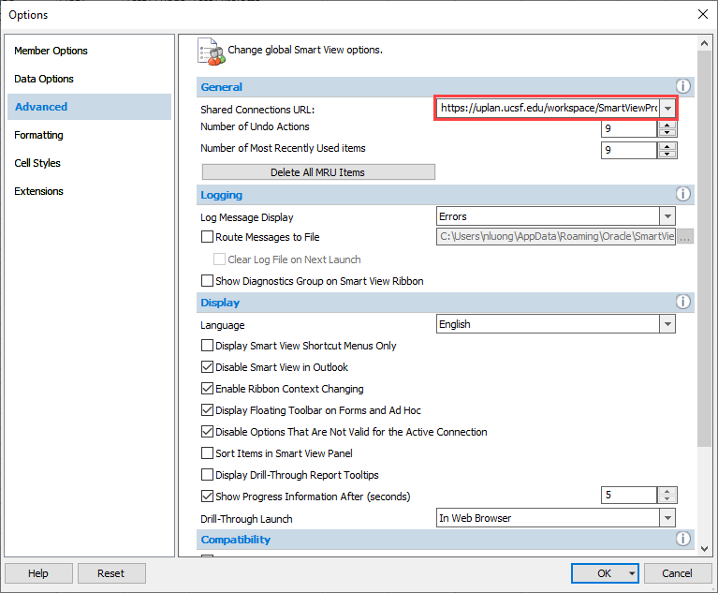
Step 1: Set up a Shared Connection using the Options icon on the Smart View tab
Smart View Ribbon > Options
Advanced tab on the left
Enter URL: https://uplan.ucsf.edu/workspace/SmartViewProviders
Click triangle next to OK button > Save as Default Options

Slide 9
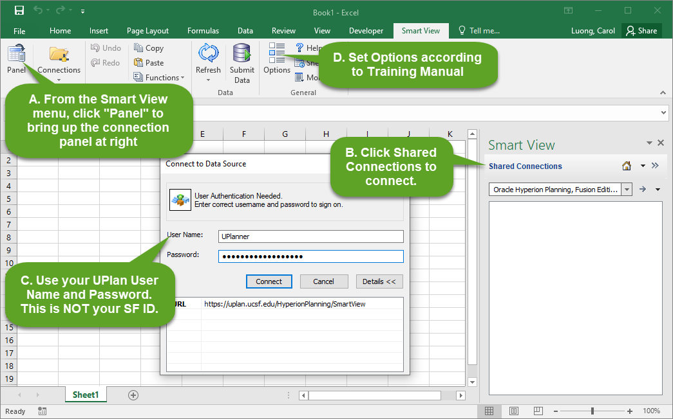
Step 2: Use the Panel icon to connect to UPlan

Slide 10
Smart View Planning Forms

Slide 11
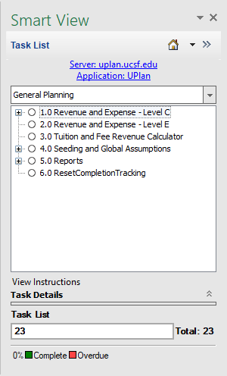
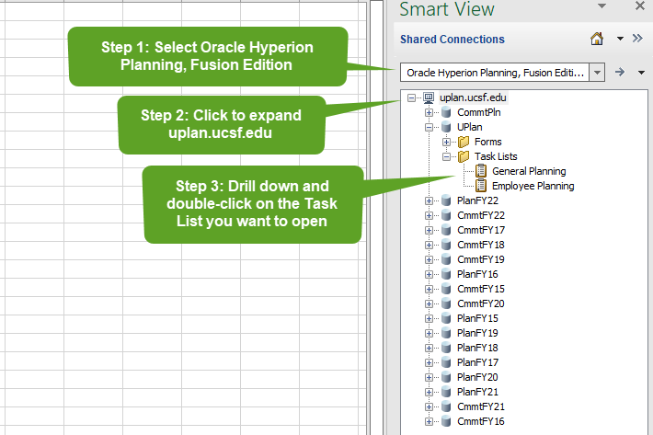
To open a planning form, drill down within Oracle Hyperion Planning, Fusion Edition
Step 4: Double-click on the form you would like to access from the General Planning or Employee Planning Task List
The Planning tab now appears

Slide 12
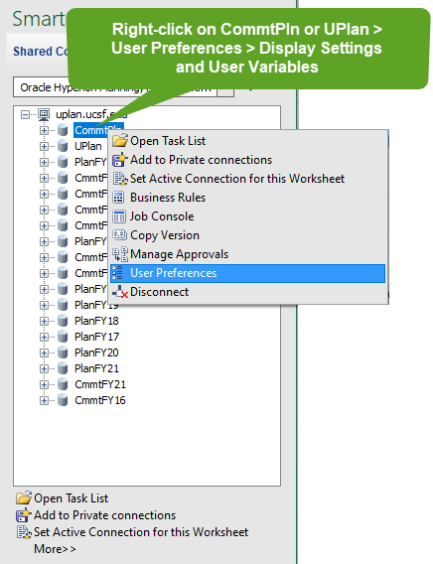
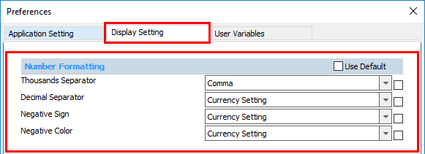
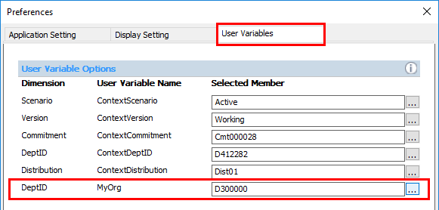
Right-click on the application in the panel to find the User Variable Options

Slide 13
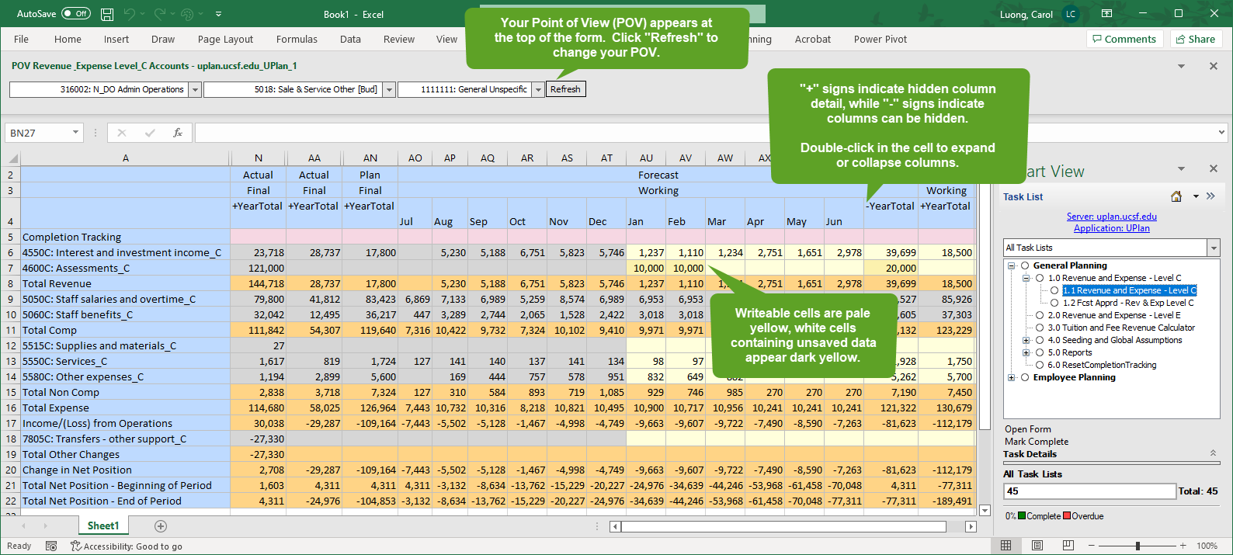
Smart View forms look similar to web forms, but some differences exist

Slide 14
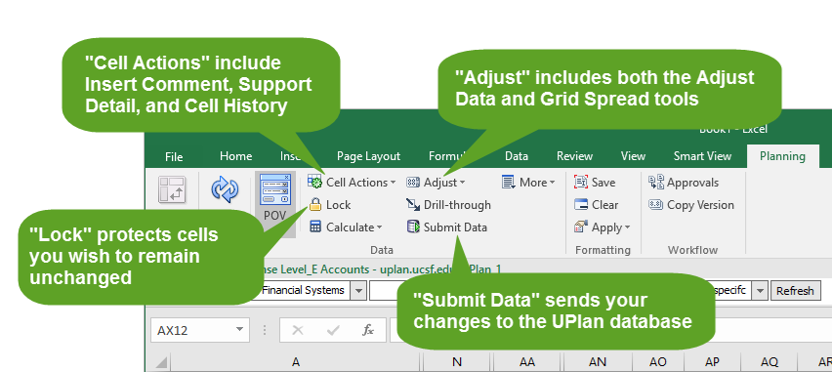
Icons on the Planning tab enable data management actions

Slide 15
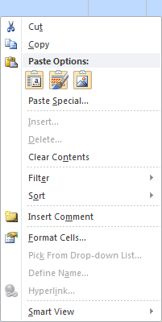
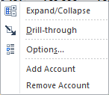
Right-click menus combine both Excel and Smart View functionality
You can copy and paste from right-click menus, or use Ctrl-C and Ctrl-V.
Right click options such as maneuvering to other forms, adding accounts, etc. appear by right clicking on right-most column > Smart View.
Note Ctrl-V only works once for each time you copy (Ctrl-C). To copy and paste multiple times, you must repeat both the Ctrl-C and Ctrl-V commands.

Slide 16
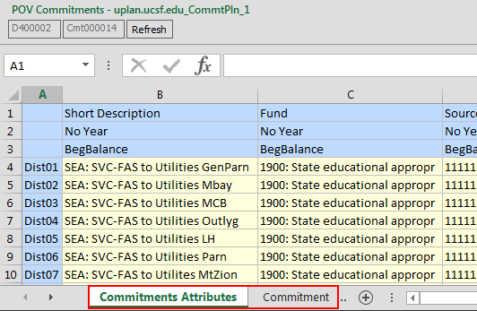
Composite forms appears as two tabs in your Excel workbooks
On the Edit Commitment form, Commitment Attributes and Commitment Dollars appear on separate worksheets and no more than one composite form can be open per application (CmmtPlan), per Excel workbook, at one time.

Slide 17
Various Excel features also work
In Smart View you can:
Move from cell to cell using your keyboard arrows
Enter data in white cells outside the boundaries of the data entry form
Reference other cells (e.g., “=B5”)
Calculate values (e.g., “=10*B5”)
Hide/unhide rows or columns just like in Excel
Freeze panes just like in Excel
Add more tabs to your Excel worksheet

Slide 18
#Missing means the cell contains no data
You can enter data in a cell that says #Missing as long as it is a writable intersection
You can eliminate data in a cell by entering #Missing instead
You can use the Options menu to change the appearance of #Missing on your forms:
From the Smart View tab, select Options > Data Options > Replacement. Enter either “NumericZero” or blank.
Note that #Missing ≠ Zero. Zero is a data value. #Missing means there is no data value.

Slide 19
When you use Excel formulas, only the result is sent to the UPlan database
In order to save your formulas for future reference, you must save your workbook locally
If you do not save your workbook locally, you can lose your formulas in several ways:
By submitting data at the same POV via UPlan web
By changing the POV in the Smart View version of the form
By re-opening the form from the Smart View panel
If you use formulas and you want to keep them for future reference:
Save your workbook locally and always use that workbook to reconnect to UPlan; never use the web forms

Slide 20
Hitting refresh will lose un-submitted data, just like on web forms
If you hit the POV Refresh button, you will lose any data that has not been submitted to the database
Just like the Go button on the web form
You will be prompted before it refreshes
If you hit the Refresh button on the Planning tab, you will also lose any unsubmitted data
You will be prompted before it refreshes
However, you will not lose formulas

Slide 21
Saving your workbook ≠ Submit
Unlike when using web forms, Ctrl+S only saves your workbooks to your local desktop or server
Ctrl+S will not submit your data to the UPlan database
If you are not using Formulas you can Submit then close your workbook without saving
To send data to the UPlan database, you must click on the “Submit Data” icon in the Smart View or Planning ribbons
Submitting Data from any tab on a composite form will submit all unsaved data on all tabs
To send data from multiple active worksheets, select the worksheets (Shift+click or Ctrl+click) and then Submit Data
Note: once you submit data to the UPlan database, the Excel “Undo” function will not reverse your changes

Slide 22
Why use Smart View?
Everything you can do in Planning Web you can do in Smart View and MORE.
If you want to use Smart View, it is highly recommended that you ONLY use Smart View to update Planning Forms and not switch back and forth between the Web and Excel.
You may lose formulas.
Requires communication with your department; control point coordinator

Slide 23
Warning
It is fast and easy to access and update your data using the forms. This also means it is easy to send bad data to the UPlan database.
Once you hit Submit Data, there is no ‘Undo’.
Be careful.

Slide 24
Users should be careful about saving and submitting data when using Smart View
Action | What it does | Risks | When to use
Ctrl-S (Save) | Saves a version of your form on your computer | Does not send data to the UPlan database | Only use if you have formulas, cell references or supplemental data in your workbook; if you do save your workbook locally, always use it to make further changes to your plan/forecast
Refresh | Refreshes the data on your form with current data from the database for the POV selected | Does not save or submit any changes you made (except formulas are retained) | If you have made a mistake that has not yet been submitted to UPlan and want to start over
Submit Data | Sends data to the UPlan database | Does not save data locally; cannot Undo after you Submit Data | Often – while you don’t need to submit data every time you make a change, submitting frequently ensures you don’t lose your work
Open Form | Re-opens your form with current data from the UPlan database for the POV selected | Does not save or submit any changes you make (including formulas) | Only as a last resort

Slide 25
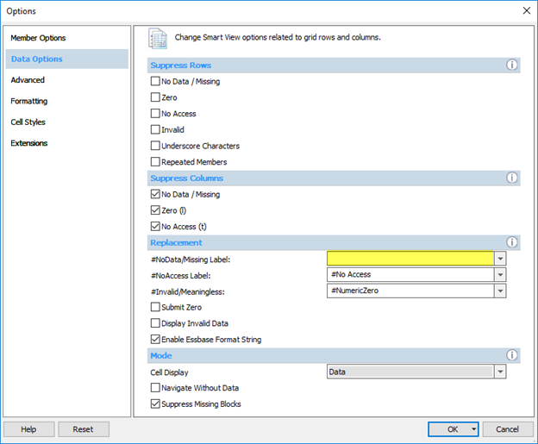
Tip: Use Options to improve how your data appears on your forms
Under Data Options:
Under Replacement, delete the value for #NoData/Missing Label
Under Formatting:
Select “Use Thousands Separator”

Slide 26
Tip: For Commitment Tracking, start with the Search Commitments form
Change the POV to the commitment you want
Select Smart View > Edit Existing Commitment from the right-click menu on the Distribution
A new Excel workbook will appear with two tabs
Add new distributions or edit existing data as needed
After entering data, submit it to the UPlan database
If you’re not using formulas, you can close the workbook with saving
Use the original Search Commitments workbook to select a new commitment for editing

Slide 27
Troubleshooting
See the Troubleshooting section of the Training Manual
Contact your UPlan Control Point Coordinator or email uplan@ucsf.edu

