Slide 1
Recharge Kick-off Meeting
Recharge Activity Review Process for 2022-23
Recharge Review
Budget & Resource Management
Michael Baldelli, Executive Director
Gabriella Hato, Manager
Sarah Hislen, Analyst
Sarah Ritterskamp, Analyst
December 6, 2022
Notes:
Michael:
Welcome. Good morning. Thank you for joining us today for this recharge kick-off meeting to launch the Recharge activity review process for this fiscal year.
My name is….
We will answer questions during the presentation. If your question is regarding a specific issue to your department, we might get back to you after words individually.

Slide 2
The focus of today’s kick-off meeting is to review highlights, changes, and compliance for the recharge review process in 2022-23
Recharge Call documents
Proposal Development Guidelines
Annual Recharge Activity Monitoring Report
Common issues during proposal review
Upcoming Recharge Review events
Notes:
Gabriella

Slide 3
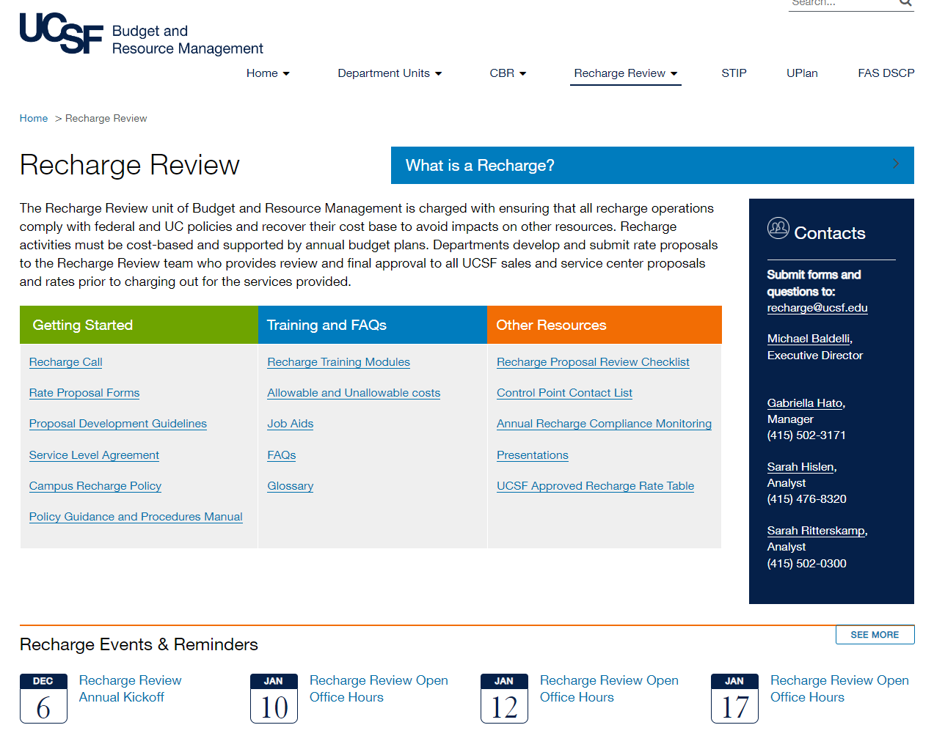
Notes:
Gabriella
First of all I would like to give a general overview of BRM and the recharge review team for those who are new to recharges and the rate review process at UCSF.
Part of the mission of Budget and Resource Management is to provide effective stewardship of campus resources.
UCSF’s Recharge Review Unit is part of Budget & Resource Management and has three staff members dedicated to reviewing and approving rate proposals for the campus
The Recharge Review unit of BRM is charged with ensuring that all recharge operations comply with federal and UC policies (to ensure the continuation of support from federal and other organizations) and recover all their costs necessary to provide services in order to avoid impacts on other resources.
There is very little concrete guidance as to how to operate service centers making compliance requirements challenging to achieve. (Each institution defines differently of what constitutes a service center and have different level of federal research funding).
At UCSF we need to consider:
federal costing compliance requirements (as federally funded research takes up a substantial portion of UCSF enterprise and we have about 200 recharge activities direct charging federal projects)
different roles and responsibilities of individuals responsible for oversight and management of service centers
A calendar of Recharge Events and Reminders – includes upcoming submission due dates and Recharge Review Open Office Hours in January
You can sign up for a time slot for Recharge Review Open Office Hours by clicking on the link in the events section and following the link within to Sign Up.
The Getting Started section includes…Recharge Call, forms, SLA, policy
The Training & FAQs section includes…
Other Resources includes…
The Recharge Review website can be found using this address, or you can navigate to our page through the Budget & Resource Management website on the top banner. Our home page gives a brief description of our charge, who we are and how to contact our team…

Slide 4
Recharge rates must be approved by Recharge Review prior to charging customers for products or services
December Annually
Recharge Review
Issues the Recharge Call Letter to Control Points and Departments with submission deadlines and guidelines
Recharge Department
Prepares recharge proposal
Recharge Department
Receives an electronic approval letter reflecting the recharge control number and approved rate(s) for their records
Establishes or adjusts existing plans in UPlan or PLUS for annual changes
Recharge Department
Submits recharge proposal
Recharge Review
Issues an approval letter
Recharge Proposal Annual Review Cycle
Internal Deadline
Control Point
Receives Category 2 proposals for functional and financial review and approval
Recharge Review
Assigns a Recharge Analyst to review for completeness, accuracy, and adherence to policy
Due in February prior to July 1st start date
Recharge Review
Receives Category 2 submissions approved by the Control Point for compliance review and approval
Receives Category 1 proposals for functional, financial, and compliance review and approval
Notes:
Gabriella
Recharge rates must be approved by Recharge Review prior to charging customers for products or services.
New recharge proposals may be submitted to Recharge Review at any time during the year, 2 months prior to the desired start date.
For recharge renewal proposals, the Recharge Proposal Annual Review Cycle begins in December annually when Recharge Review issues the Recharge Call Letter to Control Points and Departments with proposal forms, submission deadlines, and guidelines.

Slide 5
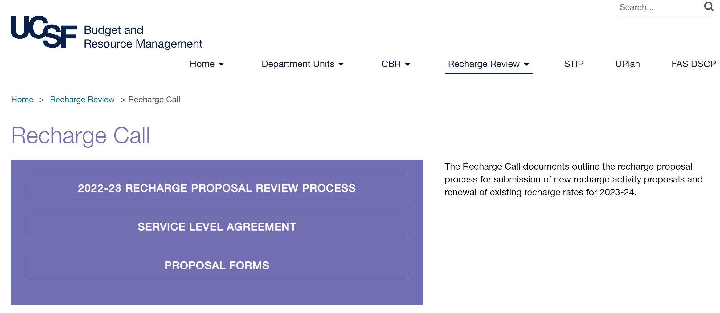
Notes:
Gabriella
The recharge call page includes the Recharge Call Letter (2022-23 recharge proposal review process), the Service Level Agreement, and Proposal forms.

Slide 6
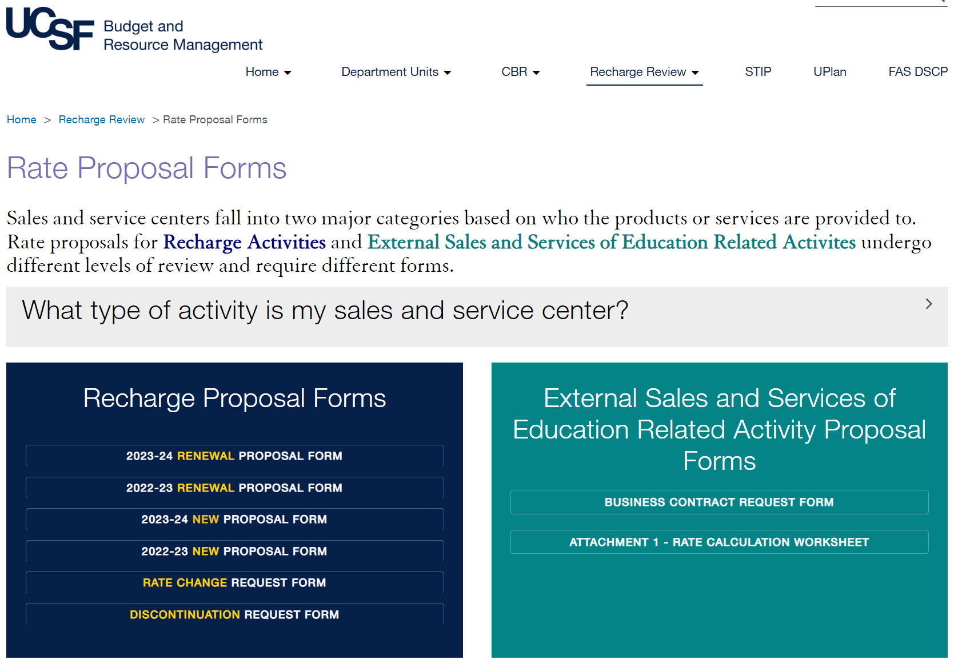
Notes:
Gabriella
The new 2022-23proposal forms for both new and renewal rates are now available on our website.
At this point in the fiscal year, any activities without a current approval, or for new activities with effective dates during the remainder of this fiscal year, please go ahead and also use the 2021-22 forms, as it will be the best way to forecast and the current year.
The standard rate change and discontinuation request forms are here too.

Slide 7
Determine the type of proposal needed from the following list and obtain rate approval from Recharge Review prior to recharging users
New recharge activity
Renewal
Rate change
Transfer of ownership
Discontinuation
External Sales & Service of Education Related Activity
establishes a recharge activity that did not exist before
used for any subsequent year of an existing recharge activity that previously received approval
a request to adjust the rates of an approved recharge activity based on changes in the operational cost without a change in the rate methodology
the ownership of an approved recharge activity is transferred from one department to another department
termination and closing out of a recharge activity
establishes a sales and service activity charging only external
users
Notes:
Gabriella

Slide 8
Recharges for academic support activities should be developed only when certain criteria are met
✓ Service will be unique or specialized, as opposed to general administration or other institutional support services
✓ Demand exists for the particular service by more than one University department
✓ There will be a significant volume of recharging, both in dollar amounts and in the number of transactions
✓ Service will be provided on a regular and continuing basis
Notes:
SaraH
New recharges may be established at any time during the fiscal year, and the rates must be reviewed and approved by Recharge Review prior to charging users.
When considering establishing an academic support recharge – the activity should be evaluated to ensure that the following criteria are met.
-unique or specialized service
-there is a demand by more than one user
-significant volume both $$ and # of transactions
-regular ongoing

Slide 9
Recharges within the institutional support function should be developed only when the following additional criteria are met
✓ Costs are for specific and identifiable services, rather than overhead costs
✓ Year-to-year activity fluctuates (dollars and customers)
✓ Charging for the activity will control demand or promote useful decisions
✓ The customer base includes sponsored projects, UCSF affiliates, and/or external users to a substantial degree
✓ The service is an allowable cost on sponsored projects
✓ The service cost was not previously included in F&A cost pools
✓ The total cost of the activity to be recharged justifies the added expense of recharge administration
Notes:
SaraH
When considering establishing an institutional support activity, these criteria should be used to help determine if the activity should funded using the recharge mechanism, or if it is more appropriate as a funding request within the budget process
Institutional support recharges should only be established with the following criteria are met:
Cost are for specific identifiable services – rather than overhead costs
Year to year activity fluctuates – both in terms of dollar amounts and customers
Charging will control demand or promote useful decisions
It is a revenue generating activity – meaning the customers include sponsored projects, affiliation and/or external users
Service is allowable on sponsored projects and was not previously included in the F&A cost pool
Total cost of the recharge activity justifies the added expense of administration
If these criteria are not met, funding for the activity should be requested through the annual budget process as a budget request

Slide 10
Recharge Proposal Submission Guidelines
Type of Proposal | Submission Date | What to Submit
New recharge activity | Two months prior to the desired start date | New Proposal Form
Renewal of 2023-24 rates | By February 24, 2023 or other assigned deadline | 2023-24 Renewal Proposal Form
Rate Change of approved 2023-24 rates | Between April 14, 2023 and May 31, 2023 | Rate Change Request Form
Discontinuation | One month following the end date | Discontinuation Request Form
Transfer of Ownership | One month prior to transfer to new department | Signed agreement between departments
Risk Category | Submit to
Category 1 | Submit directly to Recharge Review for functional, financial, and compliance review, and copy the Control Point
Category 2 | Submit to the Control Point for functional and financial review, then the Control Point will forward proposal to Recharge Review for a compliance review and final approval If user committee endorsement of proposed rates is needed, at the time of submission identify the committee members. It is recommended to obtain endorsement of the proposed rates from committee members after the proposal has been reviewed by the Control Point and Recharge Review and the rates are ready for final approval. Timing of this step will be recommended by the assigned Recharge Review analyst during the review process.
Notes:
SaraH
This table outlines the recharge proposal submission guidelines for each type of recharge proposal, including the submission date, what to submit, and to whom.
Category 2: Please allow time for all of these steps prior to submission to Recharge Review. If you are not sure when to submit to your control point, you can contact them or your dean’s office to find out the departmental deadline.
User committee endorsement is required for activities with annual plan of $500k or more. If your proposal needs user committee endorsement, we recommend that you identify the user committee members at the time of the submission. Allow the control point and recharge review to review the proposal to ensure that the rates are ready for final approval and endorsement by the user committee.

Slide 11
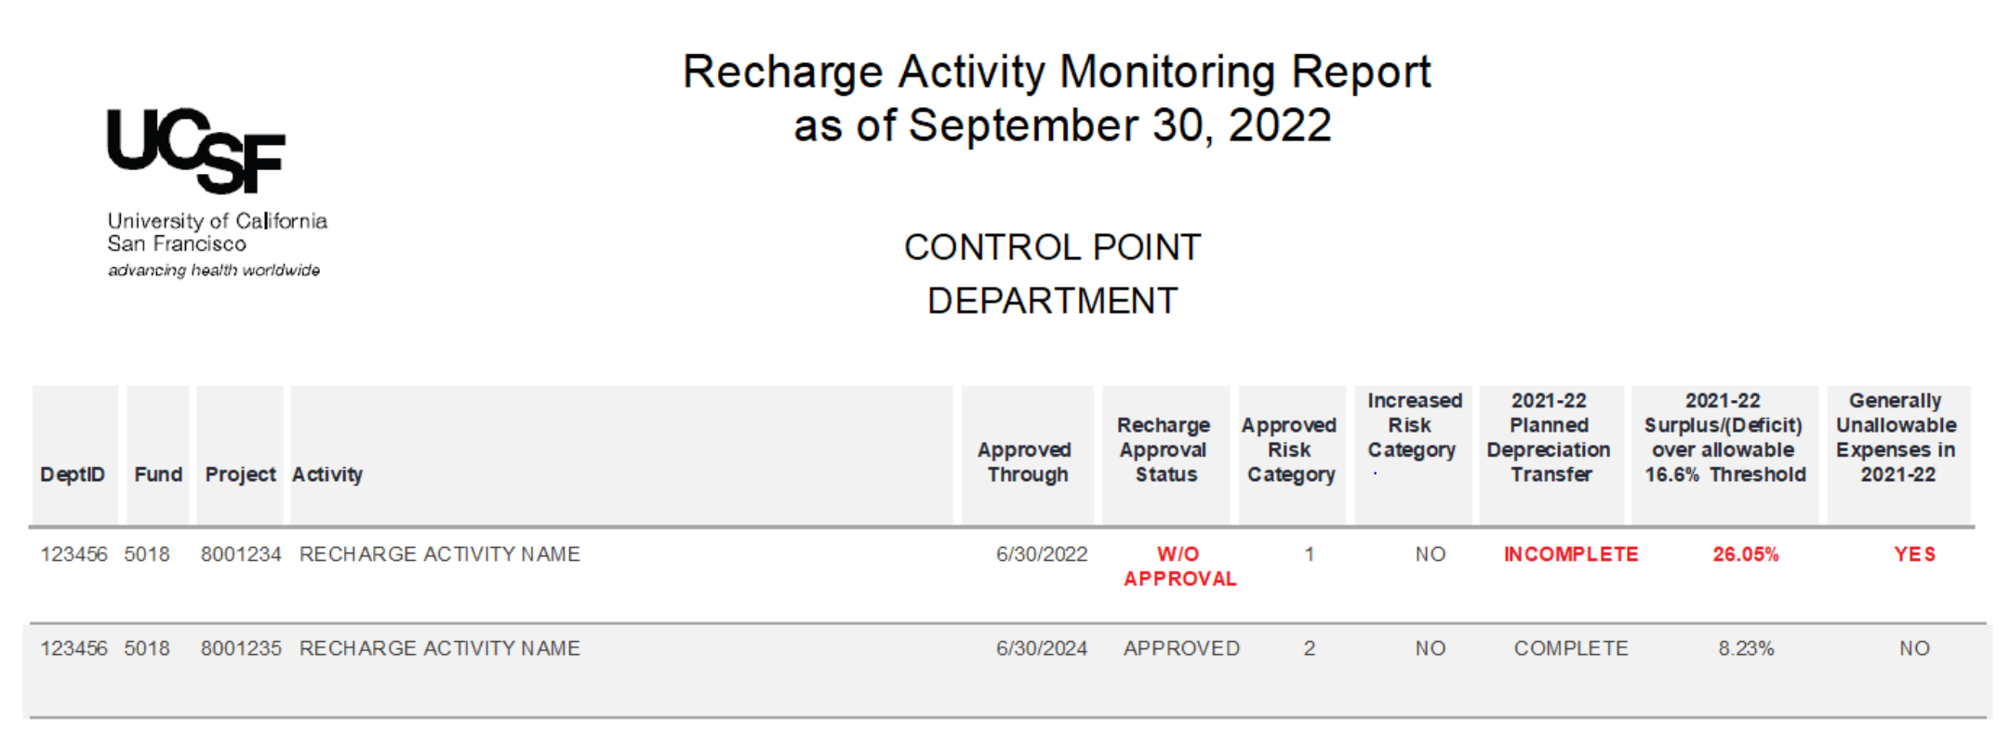
Budget and Resource Management undertakes an annual high-level recharge activity review
To monitor recharge management and compliance with federal regulations
Highlights areas for recharge departments to focus on in order to bring recharge activities into compliance
Notes:
SaRah
We completed the 2022-23 Recharge Activity Monitoring Report in October and distributed it to the recharge department contacts and control points, along with descriptions of compliance assessment metrics and recommendations on actions to bring activities into compliance.
This annual summary report is a supplement to the review and approval of recharge rate proposals.
We prepare this high-level analysis in order to monitor recharge management and compliance by comparing data collected from the recharge database with 2021-22 GL transactions and ending net positions.
While the responsibility for compliance with federal and UC policies rests at the department level, this report helps to identify compliance issues and minimize the risk of unallowable charges to federal funds.
Our Recharge Compliance Monitoring webpage has this sample report, as well as the Compliance Assessment Matrix and Recommended Corrective Actions.
We evaluate recharge activities for compliance in a number of areas, as you see in the columns: approval status, risk category, depreciation transfers, surplus/deficit balances, and unallowable expenses.
The Approved Through date is when the current rates expire.
And any indicating Without Approval in the Status column, need to submit a renewal proposal immediately.
The Approved Institutional Risk Category is determined based on the planned expenditures and anticipated federal fund participation.
And the Increased Risk Category is based on the evaluation of 2021-22 actual expenses and federal fund participation to determine whether or not the institutional risk has increased (for example from Low Risk up to Category 1 or 2, or from Category 1 up to Category 2).
Recharge activity approval duration is set based on the risk level, so when a level increases, the activity would no longer qualify for as long of an approval duration.
For depreciation transfers, the GL is reviewed to determine whether the 2021-22 planned depreciation, based on the last approved depreciation schedule, has been transferred to the renewal and replacement reserve fund.
Incomplete indicates that either nothing was transferred or that the transferred amount does not match the approved amount and that there has been a change to depreciation expense.
And this means we need an updated depreciation schedule. Not only is this important for recharge rates, but also for us to provide an accurate recharge equipment list to the Costing Policy, so these assets are excluded from F&A.
The surplus/deficit balance calculation changed this year based on the revised UC Financial Accounting Policy BFB-A-47 which now allows over or under recovery of 2 months of a recharging unit’s activity, 16.6% of annual expense. I will talk more about this in a few slides. Based on this guidance, we now calculate this by dividing the 2021-22 yearend net position by the ACTUAL 2021-22 expenses that posted to the GL. Net Position divided by Actual Expense.
In any given fiscal year, the surplus or deficit balance in a recharge activity should not exceed the allowable 16.6% threshold.
We also no longer factor in budgeted working capital from the calculation, as it will be based on actuals.
This also makes this calculation simple to evaluate yourself on a monthly and annual basis.
And last, we review if generally unallowable expenses were charged to the recharge project in during the year without approval.
Any items highlighted in red are out of compliance and need to be addressed by the department based on our Recommended Corrective Actions
Are there any questions about the monitoring report?
We have updated our monitoring report compliance trends based on these categories to share with you.

Slide 12
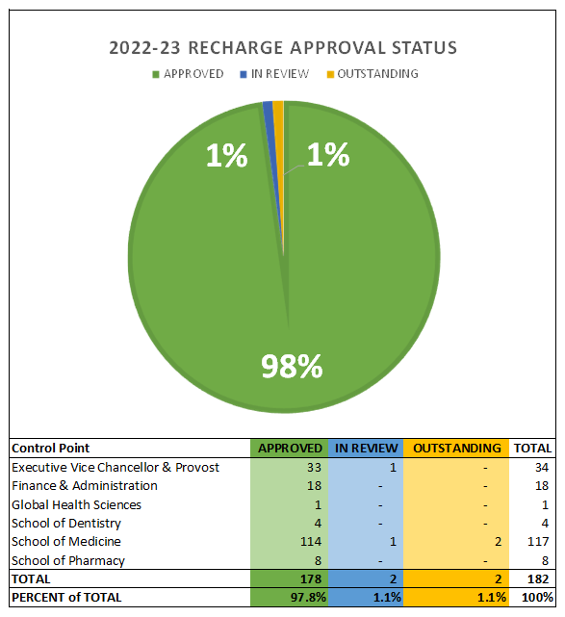
Notes:
SaRah
This is the Recharge Approval Status report I prepare monthly, and this is the current status.
There is a high level of visibility of recharge approval status by Control Point and the CFO sees this status on a weekly basis.
We should have 100% approval at the beginning of each fiscal year, so that we are in compliance by having approved rates for the entire year.
While we are very close this year, you can see that we still have a couple outstanding proposals this year.
So if you have an outstanding proposal, please submit it right away – do not wait for the February submission deadline.

Slide 13
Notes:
SaRah:
You can see we drastically improved the approval compliance this past year – so thank you to all of you that helped us make this happen. We reached the 100% approval status for 2021-22 on June 30th this year. However, as I mentioned, we actually need to reach the 100% approval at the beginning of the fiscal year on July 1st. We hope to have 2022-23 reach 100% approval much earlier this year, and also reach 100% compliance for 2023-24 by this coming June 30th with help from all of you.

Slide 14
Notes:
SaRah
This chart shows the % of completed depreciation transfers, which took a hit this year, and we need to improvement it.
What we mean by “Depreciation Transfer Complete” is that the financial journal to transfer the planned depreciation expense from the recharge to the reserve fund using Account 59025 has posted before yearend close, as well as the amount matches the most recent depreciation schedule we have on record.
Of the depreciation transfers that were incomplete in 2021-22 – 19 (26%) had no transfer at all, and 11 (15%) had a transfer that did not match the approved depreciation schedule for 2021-22.
An updated depreciation schedule should be submitted to us any time there is any change, so we can update our records and tie the annual depreciation transfers.
You may ask, why is it important to transfer depreciation on time? There are a few reason:
First, it is an expense included in the rates and we have charged users (especially federal users) for it.
Second, since it has been collected, it should be transferred to the reserve fund for future capital purchase, which is the purpose of collecting deprecation.
And last, transferring it by yearend close helps reflect the recharge’s true ending balance.
Any questions about depreciation?

Slide 15
Changes to BFB A-47 – Surplus/Deficit threshold
The revised UC Financial Accounting Policy BFB-A-47 Direct Costing Procedures now allows over or under recovery of 60 days (two months) of a recharging unit’s activity (16.6% of annual expense).
In preparation of the Monitoring Report we found that:
25% of recharge activities had surpluses over the allowable threshold, and
26% of recharge activities had deficits over the allowable threshold of 16.6% in 2021-22.
Risks of large surplus/deficit balances:
Federal audit
Rate fluctuations
Impact on other University resources
Notes:
SaRah:
As I mentioned earlier, the new update this fiscal year is that the allowable surplus and deficit balance threshold increated from 8.3% to 16.6%, (1 month to 2 months), and we also are reviewing based on actual annual expense rather than annual planned expense for the monitoring report. Even with this expanded threshold, we still had just over 50% of the recharge out of compliance.
It is important to deal with the surplus/deficit balances as soon as possible, as there are 3 risks
Audit Risk, Risk of Rate Fluctuations, and Risk using University Resources
When there is a high surplus, it indicates that users are being overcharged.
And if these users are using federal funds, the federal government is being overcharged and could result in a federal audit finding.
If there is a growing deficit, the deficit needs to be recovered in some way.
Most likely it will require a rate increase, which shifts the burden to future users.
And the larger the deficit, the larger the necessary rate increase.
If a rate increase cannot fully offset the deficit, the department will need to subsidize the recharge burdening other university resources
Every effort should be made to ensure that a recharge’s yearend net position, surplus or deficit, does not exceed two months of the recharge unit’s actual expense. It is critical that action is taken to address any recharges with net positions out of compliance, even those currently approved, by submitting revised plans and rate calculations to Recharge Review as soon as possible.

Slide 16
Count
Tier
Percent
9
Surplus over 100%
10
Surplus 50 – 100%
27
Surplus 16.6 - 50%
90
+/- 16.6% (In compliance)
21
Deficit 16.6 - 50%
14
Deficit 50 -100%
13
Deficit over 100%
Notes:
SaRah
This chart visualizes the 2021-22 yearend Net Positions Compared to Actual Expense, and where they fall within the Allowable Threshold of +/- 16.6%.
The goal for recharges is to reach breakeven at year-end, or maintain a net position that is close to breakeven.
The blue area of the scatter plot is the allowable threshold, and 49% of the recharges are in compliance (up from 43% in 2020-21)
As you can see though, there are many recharges out of compliance, and some need to take immediate action.
Note that the compliance assessment is based on different criteria than in past years: 16.6% over/under compared to actual expense (rather than 8.3% over/under planned expense)
The further you are away from the 16.6% threshold, the more urgency there is to address the balance by reviewing and adjusting the plan and rates.
Rates should be adjusted to address surplus/deficit balances, and this is done through the reconciliation process in the proposal.
We know that this is a snapshot in time at fiscal close, so there can be timing issues and the balance is a moving target, but general this is a trend we are seeing.
Our goal is for all 12 recharges with a surplus/deficit of over 100% to take corrective action immediately and fall closer to the allowable threshold by yearend.

Slide 17
Notes:
SaRah
And last, we have Allowable Costs Compliance. This has greatly improved over the years.
And appreciate everyone’s hard work to keep unallowable expenses off recharge chartstrings.
Or for transferring these expenses off in a timely manner.
I believe we can reach 100%!
If your monitoring report shows that unallowable expenses were found on a recharge, a second attachment is included showing the transaction details. It is important to correct or transfer these right away, and to keep an eye out for similar transactions throughout the year.
A few types of unallowable transactions we regularly observe are:
incorrect accounts use (furniture instead of office supplies, social activities/entertainment/alcohol for gas and alcohol supplies, etc.),
some are truly unallowable costs (lunch meetings, equipment, etc)
Dedicated phone lines can be allowable, but the quantity of phones must be approved by Recharge Review.
And capital equipment $5k and above is never allowed.
Check out the unallowable expense list on our website, specifically the expandable section that shows the expense account numbers.
And just below that is a link to the step-by-step guide on Setting up a Monthly Automated Unallowable Expense Report in MyReports.
Thank you for your time, I will pass it back to Sarah Hislen

Slide 18
Common issues during proposal review
Expense allocation assumptions are missing from the rate calculation
Lack of required reconciliation for multi-service recharges
Subsidies are not always disclosed
Depreciation schedules are inconsistent
Over-complicated rate calculations
Recharge activity is not recharging on a monthly basis
Capital equipment being charged directly to the recharge operating chartstring (Fund 5018)
Non-capital equipment and other operating expenses are charged to the equipment reserve fund (Fund 5500)
Recharge for services without approved rates
Required approvals are missing from proposal submission
Notes:
SaraH
Recharge Review is committed to approving 2023-24 renewal proposals and rates that are submitted by the assigned submission deadline before July 1, 2023.
We can review and approve proposals more quickly when complete proposals are submitted to our office. The more questions and issues that arise during the review, the longer the review can take.
The following are some of the more common issues that we see during our reviews.
Assumptions are missing: It’s best to document assumptions for calculating FTE effort and expense estimates, as well as the method is used to allocate FTE effort or expenses across various services in the recharge proposal
Reconciliation missing: When a recharge provides more than one service, ensure that a reconciliation of expenses and revenue for each service is included in the recharge to support the allocation of the prior year balance applied to each service
Disclose subsidies: It is important to disclose any subsidies in the recharge proposal. All costs related to providing the service should be charged to the recharge and subsidies should be included in the proposal to ensure that they are recorded appropriately so they are excluded from the F&A cost pool, federal subsidies require special handling and reporting, so it is essential that we know about these.
Ensure that information in the depreciation schedule aligns with data in the asset management system, and if you have equipment depreciation included in your rates, that you transfer the amount that is reviewed and approved by recharge review each fiscal year.
Try to avoid over complicated rate calculations – remember that the simpler the methodology, the easier it should be to reconcile the expenses and revenue in the next renewal. For example – consider applying a single hourly rate for effort based services rather than multiple rates for custom projects.
Make sure recharge journals are processed on a monthly basis to ensure that you collect recharge revenue to offset expenses (before sponsored awards close)
Make sure capital equipment is not charged to the recharge operating fund
Ensure that the renewal and replacement reserve fund is not being used for recharge operating expenses – this should typically only be used for capital expenses related to renewal and replacement of capital equipment.
Make sure that you are only charging approved recharge rates
Make sure that you have required approvals (MSO, Control Point) at the time of submission

Slide 19
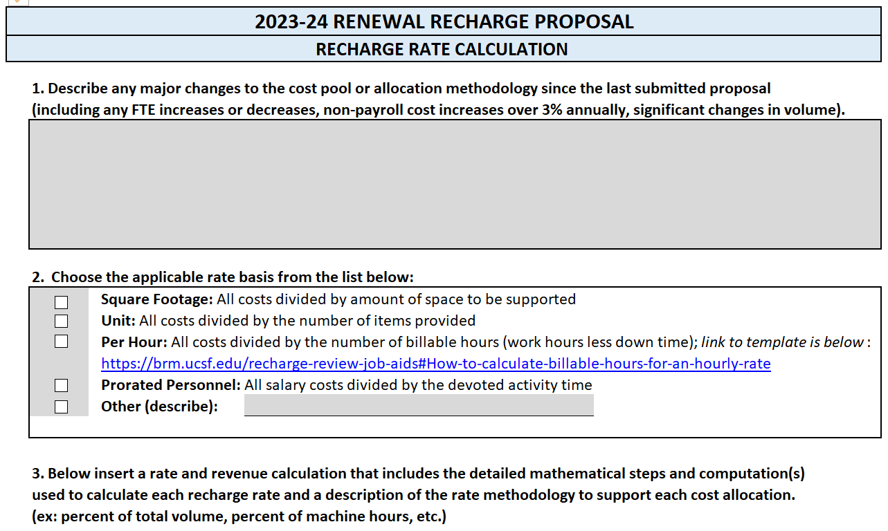
Justify major changes in Recharge Rate Calculation tab
Notes:
SaraH
We added section 1 to the rate calculation tab last year as a reminder to describe any major changes to the cost pool or allocation methodology since the last proposal submission to help make the proposal easier to understand and speed up the review process
FTE changes are one of the common issues not explained
We do not always have backup for significant changes (example: annual maintenance costs (non-service contract))
Feedback: Let us know if anything is confusion in the proposal forms

Slide 20
Upcoming Recharge Review Events
Recharge Review Open Office Hours (via Zoom)
January 10, 12, 17, and 19, 2023
9:00 AM - 4:00 PM
Recharge Renewal Proposal Submission Deadline
February 24, 2023 (or other assigned deadline)
Notes:
SaraH

