Slide 1
Composite Benefits Rates in UCPath Integration
Budget & Resource Management & Controller’s Office
September 26, 2019

Slide 2
Summary
A composite benefits rate is the cost of employee benefits as an average percentage of gross salary cost applicable to an employee group.
UCSF will implement Composite Benefits Rates (CBRs) when we implement UCPath, scheduled for February 2020
Rationale:
  Simplifies and improves planning process
  Eliminates variation in department costs due to employee benefit selections
  Reduces workload when transferring compensation expenses among fund sources

Slide 3
CBRs will be implemented along with the UCSF launch of UCPath
Year | Month | Activity
2019 | August | Campus submitted proposed model to UCOP
 | September | UCOP signed off and submit to DHHS
 | September – December | Grant proposals begin using proposed rates CBR website and FAQ coming soon DHHS reviews and approves UCSF proposal
2020 | February | CBRs will apply to monthly pay
 | March | CBRs will apply to bi-weekly pay
 | March – June | Campus makes adjustments to recurring budget allocations to address cost shifts

Slide 4
Composite Benefit Rates (CBRs) support UC Path integration and simplify accounting processes
A composite benefits rate is the cost of employee benefits as an average percentage of gross salary cost applicable to an employee group.
For example, if gross salary for faculty is $750 million and benefits costs for this group is $150 million, the composite benefits rate is 20%
Current State: |  | Future State:
Actual costs for individual benefits by employee |  | Composite benefits rates based on type of employee
Departmental costs vary due to employees’ personal circumstances |  | Eliminates variation in department costs related to employee benefit selections
Planning is more complex and less accurate |  | Simplifies and improves planning processes
Payroll transfers require adjustments for individual benefit lines |  | Reduces workload when transferring compensation among fund sources
Notes:
Reduces workload when transferring compensation expenses among fund sources
Simplifies and improves planning processes
Eliminates variation in department costs due to employee benefit selections
Required by UCPath?
Possibly add,
*significantly easier integration into new payroll system UC Path
* Provides consistent accumulation and allocation of fringe benefits expenses (to functional activities as required by Cost Accounting Standards)

Slide 5
Our goal has been to identify a CBR model that best balances several competing principles
Simplicity | Models should be easy to understand and implement. Employees should be grouped in a rational, logical, and easily identifiable way.
Minimized Impact | Cost shifts across funds, control points, and employee types should be minimized.
Accurate Accounting | Expenditures assigned to specific lines of University business should accurately reflect the true cost of that business line.
Notes:
Consider moving after timeline

Slide 6
Our CBR model development is based on certain key assumptions and constraints
Most individuals who share a job code will be assigned the same benefits rate
  Individuals with less than full benefits will be assigned a Partial/Minimum/ Students rate (except Post Docs)
Some compensation components will not be charged benefits in the new model (e.g., Z incentive payments, housing allowances)
Salary components for an individual that are charged (e.g., the X and Y components of faculty salaries) will be assigned the same benefits rate
The vacation leave assessment will be handled separately
UCSF Health will charge its own rate(s); the rate applied to jointly-funded faculty and staff will be based on the business unit making the salary payment rather than the home department of the employee
  Current UCPath change request in process

Slide 7
Fringe Benefit Costs Included in CBR
Health and Welfare | Taxes | Retirement
Health Insurance Contribution OBEP Health Dental Insurance Vision Insurance Benefits Administration Employee Support Program Core Medical Insurance Life Insurance Senior Management Supplement Post Doc (PSBP) Broker Fee PSBP Life Insurance Core Life Insurance | OASDI Medicare Workers Compensation Unemployment Insurance UCDI Insurance PSBP Disability PSBP Workers Compensation | UC Retirement Plan URP Supplemental Assessment Principal
Notes:
Original format to slide 8

Slide 8
Fringe Benefit Costs Excluded from CBR
In PS_UC_LL_FRNG_DTL:
  Vacation Leave Assessment (VLA)
    3 separate rates identified; only salary covered, rates TBD
  UCRP STIP loan repayment component
  General, auto and employment liability (GAEL)
In PS_UC_LL? TBD:
  Graduate student tuition and fee remissions
Not in UCPath:
  Faculty childbearing and childrearing assessment

Slide 9
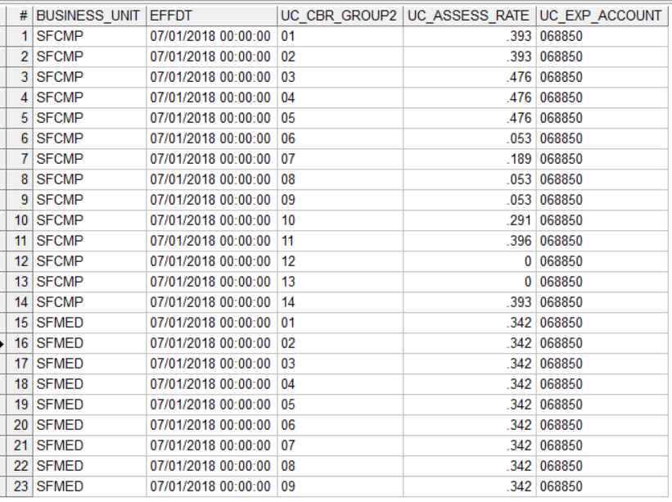
UCPath CBR Groups
Assessment Rate Setup for CBR is stored in PS_UC_CBR_RATE
UCSF has distinct sets of rates for SFCMP and SFMED
Group definitions 1-9 are delivered
Groups 10-13 are available for locations to create customized definitions
SFCMP has two customized groupings – UC CBR GROUPs 10 and 11 (note these carry descriptors of Campus Rate #1 and Campus Rate #2!)
All group definitions/attributes are stored in PS_UC_CBR_SETUP

Slide 10
UCPath CBR Groups
UCSF CBR Groups
Faculty Tenure,
Clinical,
In Residence
UCPath Group | UCPath Group Description
1 | Faculty Not HSCP – Full Benefits
2 | Faculty HSCP – Full Benefits
3 | Other Academics – Full Benefits
4 | Staff Exempt – Full Benefits
5 | Staff Non-Exempt – Full Benefits
6 | Students – Graduate/Undergraduate
7 | Post Docs
8 | Faculty/Staff-Partial Benefits
9 | Faculty/Staff – No Benefits
10 | Campus Rate #1 – Full Benefits
11 | Campus Rate #2 – Full Benefits
12 | Campus Rate #3 – Full Benefits
13 | Campus Rate #4 – Full Benefits
14 | Faculty Not HSCP Summer Salary – Full Benefits
Faculty
Non Tenure,
Adjunct
Academic and
Staff
Management &
Professional
Post Doc
Student and
Non Full Benefit
Notes:
Original format to slide 8

Slide 11
UCSF’s proposed model uses six categories
Category | Category Members (examples) | Count | Salary (millions) | Composite Rate
Faculty Tenure, Clinical, In Residence | Ladder Rank – Associate and Full Health Science Clinical Professor Professor of Clinical ______ Professor in Residence | 2,507 | $576.1 | 24.5%
Faculty Non Tenure, Adjunct | Non Ladder Rank – Assistant Adjunct Professor Visiting Professor | 516 | 56.3 | 34.7%
Management & Professional | Managers Pharmacists, Physicians, Dentists Nursing Services, Police Services | 5,409 | 135.8 | 36.4%
Other Academics and Staff | Specialists, Administrative, Budget, and Personnel Analysts, Computer Programmers Animal Care Technicians, Laboratory and Allied Services Custodial Services, Parking and Guard Services | 14,715 | 595.2 | 45.3%
Postdoctoral Fellows | Postdoctoral Fellows | 2,015 | 60.8 | 20.4%
Partial/Minimum/ Students | Students and Residents All employees with appointments offering partial or minimum benefits | 9,706 | 180.6 | 5.2%
Notes:
Original format to slide 8

Slide 12
How to determine CBR for an employee
Determine CBR grouping for employee/position
Determine if ERN CD associated with earnings line is eligible for CBR (ERNCD UC_CBR = Y)
Eligible earnings * CBR = Assessment
Assessment recorded in PS_UC_LL_FRNG_DTL
  LINE_DESCR = “CBR Assessment – Expense”
  UCOP LL Account = “068850”

Slide 13
CBR Assessment Grouping and Rate Logic
UCPath looks for combination of employee and job characteristics in a particular sequence from most to least restrictive (see table PS_UC_CBR_SETUP)
ELIG_CONFIG1 is pulled from employee’s benefit eligibility associated with primary job
PS_UC_LL_EMPL_DTL carries the CBR grouping that the system has determined for the employee
  Columns UC_CBR_GROUP_DESCR, UC_CBR_RATE
SFMED or SFCMP rates? Currently* based on HR Business Unit associated with the position
Match on most restrictive campus specific characteristics (BU, JOB CODE, FLSA, ELIG CONFIG1, EMPLOYEE CLASS)
Match on FLSA STATUS, ELIG CONFIG1, EMPLOYEE CLASS to look for Staff – Exempt, Staff – Non-Exempt, Faculty/Staff – Partial Benefits or Faculty/Staff – Not Benefits Eligible
Match on JOB CODE, ELIG CONFIG 1, EMPLOYEE CLASS for grouping Faculty – HSCP
Match on ELIG CONFIG 1, EMPLOYEE CLASS for groupings Faculty – Non-HSCP, Other Academic, Faculty/Staff – Partial Benefits or Faculty/Staff – Not Benefits Eligible
Match on EMPLOYEE CLASS for groupings Post Docs or Students

Slide 14
Earnings and CBR Eligibility
Locations worked with UCOP to identify earnings codes that should be eligible for CBR assessment and those that should be excluded
ERN codes attributes are set at the systemwide level
  Any potential changes in the CBR attribute assignment are subject to UCOP/UCPath governance processes, including formal review and impact analysis for all UC locations
Earnings are eligible for the CBR assessment when ERNCD UC_CBR = Y
Query PS_UC_ERNCD for full list of ERNCDs and CBR attributes

Slide 15
CBR expenses in GL
Fringe table CBR expenses are mapped to UCSF accounts in the journal generator process
  If it’s an SFMED business unit transaction:
    Map to Alt Account 62084
  If it’s an SFCMP business unit transaction:
CBR Expense Category | UCOP Sub + Object Code | Empl Class | Map to Account
Faculty | 068850 | 9 | 50575
Non-faculty Academic | 068850 | 3, 10, 11, 22, 23 | 50576
Staff | 068850 | 1, 2, 4, 5, 6, 7, 8, 13, 15 | 50574

Slide 16
CBR Tables
PS_UC_CBR_RATE: rate sets for SFMED and SFCMP
PS_UC_CBR_SETUP: criteria used to define CBR groupings. Groupings 1-9 are delivered; SFCMP has created additional custom groupings 10 and 11 based on Job Code criteria
PS_UC_ERNCD: is ERNCD subject to CBR? (UC_CBR = Y)
PS_UC_LL_EMPL_DTL: criteria from employee and job record used to determine CBR grouping/rate*
PS_UC_LL_SAL_DTL: Salary detail– amount and ERN CD used in CBR calculation
PS_UC_LL_FRNG_DTL: CBR assessment expense is recorded in LL
PS_ZGL_LL_ACCTG_LN: CBR assessment expense is mapped to appropriate UCSF expense account

Slide 17
Implementations at other campuses have been relatively smooth
Davis moved to CBRs in 2011, initially with 13+ rates, now down to 10 rates. Current CBR submission is under review by CAS
Berkeley implemented in 2012-13 and now has 4 rates (academic, staff, students, and limited)
UCLA launched September 2018 with 7 rates, similar to our proposal
  Full and Associate HCOMP faculty separated from other faculty
  Postdocs separated
  Other academics and staff in three categories, including a high-rate category for food service, custodial and grounds workers

