Slide 1
UPlan Commitment Tracking
Budget & Resource Management
Spring 2024

Slide 2
© [2023-2024] “University of California San Francisco (UCSF)”
Ownership of Copyright
The copyright in this material (including without limitation the text, artwork, photographs, and images) are owned by UCSF.
Copyright License
UCSF grants to you a non-exclusive royalty-free revocable license to:
- View this material on a computer
- Store this course in your cache or memory
- Print pages or material from this course for your own personal and non-commercial use.
All rights reserved.
Enforcement of Copyright
UCSF takes the protection of its copyright very seriously. If UCSF discovers that copyrighted materials have been used in contravention of the license above, UCSF may bring legal proceedings against you seeking monetary damages and an injunction to stop you from using the materials.

Slide 3
Contents
Commitment Tracking Overview
Commitment Tracking Data Elements
Commitment Tracking Forms
Commitment Tracking Reports

Slide 4
Overview of Commitment Tracking

Slide 5
A Commitment is a planned financial transfer
Recurring allocations
Ongoing distributions from a source unit to target unit
Prior to UPlan, many were maintained in the “permanent budget”
Temporary allocations
Promises to provide funding for specific activities
Often based on a negotiated agreement
May include specific uses and conditions
Prior to UPlan, means to document were varied and inconsistent
Notes:
Ongoing distributions from a source unit (e.g. Chancellor, Control point) to target unit (e.g. department)
Prior to the UPlan, temporary allocations were documented in numerous and different ways:
letters, emails, notes from a meeting, verbal communication, local tracking system

Slide 6
Commitment Tracking is a UPlan module to plan transfers
Commitments are entered by planners for the source unit
If an approval date is included, commitments automatically flow to plans for the target unit
Features include:
11-year planning timeframe
Automatic feed to General Planning for Years 0, 1, and 2
Reports to analyze commitment activities

Slide 7
Three years of commitment data flows to General Planning
Amounts flow into UPlan-only transfer accounts based on the assigned Fund and Transfer Type
Commitments flow to both Source and Target DeptIDs
Target DeptID sees the commitment in General Planning only if Approval Date and other required data are entered
Integration is updated hourly
Notes:
Three years (current year plus two planning years) of commitment data from the most recent plan/forecast will flow from Commitment Tracking into the existing dimensions in General Planning. These will be updated on an hourly basis. The amounts will flow into UPlan-only transfer accounts based on the assigned Fund and Transfer Type and month/Year. Commitment totals in the General Planning module will be aggregated by DeptID, Fund, Project, and Account.
For more information on the mapping of Commitment transfer types to General Planning Tfr accounts, see the appendix at the end of this lesson.

Slide 8
Commitment Tracking Data Elements

Slide 9
The module contains many data elements to enhance commitment tracking
The following data elements are required or necessary for full integration of the commitment with General Planning
Member | Description
Commitment | Automatically generated when you add a commitment (Number)
Distribution | Automatically generated when you add a distribution (Number)
Source DeptID | Initiator department of commitment and provider of funding (List)
Target DeptID | Recipient department of commitment funding (List)
Source Project | Source project of commitment funding (List)
Target Project | Recipient project of commitment funding (List)
Fund | Type of funding committed (List)
Short Description | Description of the commitment (Text, limited to 255 characters)
Transfer Type | Commitment type; helps identify operating/non-operating transfer (List)
Approval Date | Commitments with no approval date will be visible to the Target in the Commitment Reporting module, but will not appear as a transfer in the General Planning module. Visible to the Source Dept ID in both places. (Date)
Notes:
Red=Required for all entries
Bold= Recommended will help with managing and reporting
Italics=trigger – required when you want a specific action to happen
All others optional – but are there to help you more easily manage, track and report on your commitments in long run.
In order for the commitment to show up in the revenue & expense form, so that they can plan against in it in general planning:
Full dfp for both source and target plus the transfer type plus the approval date fields must be completed.
The short description is a highly recommended field because it is included in most commmt reports
End Date does have a functional impact; it is used only to determine whether a new Year 10 amount should be populated when the module is updated for the new year. Type a date in the format M/D/YYYY (such as 1/1/2014 or 12/31/2013) or use the calendar lookup provided.

Slide 10
Other data elements are not required; planners may determine their use
Member | Description
Function | Function code; used to track journals (List)
Long Description | Description of the commitment -- limited 255 characters (Text)
Purpose | Purpose of commitment -- for reporting (List)
Duration | Indicates whether commitment is temporary or recurring (List)
Status | Indicates whether commitments is new, ongoing, anticipated, or completed (List)
Start Month/Year | The start date of the commitment or allocation ; for reference only (Date)
End Month/ Year | The end date of the commitment or allocation; used to determine whether a commitment or allocation should “roll” to a new fiscal year (Date)
Contingent | Yes/No values; used to indicate whether a commitment has contingencies (List)
Requestor | Name of the person that requested the commitment (Text)
Date of Request | The date that the commitment or allocation was requested ; may contain a different date than the start date (Date)
Authorizer | The name of the person who approved/authorized the commitment or allocation (Text)
Notes:
Red=Required for all entries
Bold= Recommended will help with managing and reporting
Italics=trigger – required when you want a specific action to happen
All others optional – but are there to help you more easily manage, track and report on your commitments in long run.
In order for the commitment to show up in the revenue & expense form, so that they can plan against in it in general planning:
Full dfp for both source and target plus the transfer type plus the approval date fields must be completed.
The short description is a highly recommended field because it is included in most commmt reports
End Date does have a functional impact; it is used only to determine whether a new Year 10 amount should be populated when the module is updated for the new year. Type a date in the format M/D/YYYY (such as 1/1/2014 or 12/31/2013) or use the calendar lookup provided.

Slide 11
Commitment and Distribution Numbers uniquely identify planned transfers
Commitment Number
UPlan generates a unique Commitment Number sequentially for each new commitment by any user
Commitment Number format is Cmt000001, Cmt000002, etc.
All uses share the same pool of commitment numbers
Once you create a commitment, you “own” that Commitment number
Distribution Number
Identifies up to 99 individual distributions
Each new commitment automatically generates Dist01
Distributions are numbered sequentially Dist02, Dist03,...
Notes:
Commitment
All UPlan users share the same pool of Commitment Numbers.
UPlan will generate a unique Commitment Number sequentially for each new commitment entered by any user. Commitment format is Cmt000001, Cmt000002, etc.
Commitment numbers are recycled. If another user deletes a commitment, then the next user to “Add a Commitment” will get the lowest Cmt# in sequential numeric order. Also, note that commitments do not populate the Landing Page by the date the commitment was added but rather by Cmt#. The Landing Page list of commitments is not in chronological order by date created.
Distribution
The Distribution dimension identifies up to 99 individual distributions (Transfers Out) within a commitment. Each Commitment will have at least one Distribution. When you add a new Commitment, it automatically generates Dist01. (If you need additional distributions for the same commitment, you can add them, and they will be numbered sequentially Dist02, Dist03, etc.). You will identify the characteristics of this distribution when you edit the commitment itself. To Add a Distribution, you will use the right click menu.
Source and Target DeptID
Each commitment has a Source DeptID and a Target DeptID. The DeptID dimension is essentially the same for Commitment Tracking as in General Planning. However, in the Commitment form, a placeholder named ”Unspecified DeptID” is available for commitments that are being planned but

Slide 12
Separate DeptID and Project values are recorded for the source and target
Source and Target DeptID
Each commitment has a Source DeptID and a Target DeptID
The module also includes a placeholder DeptID named “Unspecified DeptID” for cases where the Target DeptID is undetermined
It is possible for the Source DeptID and Target DeptID to be the same; in these cases, presumably the Source and Target Projects differ
Source and Target Project
Each commitment has a Source Project and a Target Project
The module includes all Projects except Sponsored projects
For Recruitment, Retention, and Other Faculty/PI projects, commitments for individual projects are aggregated to corresponding ADJ projects in General Planning
It is possible for the Source Project and Target Project to be the same; in these cases, presumably the Source and Target DeptIDs differ

Slide 13
At present, Fund is the same for both the source and target of the commitment
Exception: Transfers to Plant
Fund will be as entered for the Source
Internal system logic will map the Current Fund to a Plant Fund for the Target in General Planning
Sponsored funds are not included in the Commitment Tracking module
Source Fund | Target Fund
7000 Private Restricted Gifts | 9000 Unexp plant restr gift fund
7100 Private Unrestricted Gifts | 9100 Unexp plant unrestr gift fund
Other Current Funds (under 100A) | 9105 Unexp plan university funds
9XXX Plant Fund | Value is the same as the Source
Notes:
Fund
With the exception of commitments with Transfer Type equal to “Transfer to Plant”, Fund will be the same for both the Source and Target.
Sponsored Funds
Sponsored funds are not included in the Commitments module.

Slide 14
Transfer Type helps map commitments to accounts in General Planning
Describes the type of commitment
Used with Fund to determine the appropriate “Transfer” Account in General Planning
Refer to UPlan Job Aid “Commitment Mapping to General Planning” for complete Fund/Account matrix
Defaults to NoTransferType if left blank
Notes:
Transfer Type
Transfer Type describes the commitment and is used to map Commitment Distributions to the appropriate UPlan only “Transfer” Account dimension in the General Planning module.
If the Commitment is a placeholder, you can leave this field blank and it will default to No Transfer Type.
Each of these transfer types correspond to a real revenue account (except in the case of the ”Allocations and Other Operating Transfer”). For more information on these mappings, see the appendix at the end of this lesson.

Slide 15
Approval Date is a critical data element for integration in General Planning
Required for a commitment to flow to the Revenue & Expense form in General Planning for the Target DFP
If left blank, data will not appear as a transfer for the Target DeptID in the General Planning module
Note: The commitment dollar amount will appear on the Revenue & Expense form for the Source DeptID regardless of whether the Approval Date field is completed or not
Notes:
it WILL show up on the Target DeptIDs commitments reports as an unapproved Cmt- so they’ll know you are planning to make a commitment to them, but they wont be able to plan expense against it on their R&E form in General planning

Slide 16
Short and Long Descriptions help describe commitments
Short Description is used on Commitment Reports and the Manage Commitments form
Use Short Descriptions to clearly distinguish commitments and distributions
Both fields allow for text up to 255 characters
Use Long Description for information that does not fit in another field
Notes:
Short Description and Long Description
The Commitment form provides fields for both a short description and a long description. The short description will appear on most Commitment Reports, and also on the Manage Commitments form. Users should use short descriptions that will allow for a clear understanding of the specific commitment in a way that can be sorted with other commitments. You can use Long Description for recording information that does not fit into another field.

Slide 17
Function, Purpose, Duration, Status, Contingency
Function
Smart list with 18 members
Useful for tracking journals
Purpose
Smart list with 10 members
Useful for aggregating, grouping, selecting, reporting
Duration
Differentiates temporary and recurring allocations
Status
Notes status (Anticipated, New, Active, Completed, NoStatus)
Contingency
Indicates existence of conditions that must be met before funds will be transferred
Acceptable values are Yes or No
All optional fields.
Notes:
Purpose: Helps describe the commitment and may be useful for aggregating, grouping or selecting commitments for reporting.
Duration: Use the optional Duration field to differentiate temporary and recurring allocations.
Status: Status indicates where a commitment is in the process.
Requestor, Authorizer, and Date of Request
These fields are provided to store background information about a commitment. They are not required and have no functional impact. For Requestor and Authorizer, type any text you would like. For Date of Request, type a date in the format M/D/YYYY (such as 1/1/2015 or 12/31/2014) or use the calendar lookup provided.
Approval Date
In order for information about a commitment to flow to General Planning forms for a Target DFP, the Approval Date must be completed. Type a date in the format M/D/YYYY (such as 1/1/2015 or 12/31/2014) or use the calendar lookup provided.

Slide 18
Other Optional Fields
Requestor and Date of Request
No functional impact – use to store background information as useful
Authorizer
No functional impact
Start Date and End Date
Start Date has no functional impact
End Date: used to determine if a new Year-10 amount should be populated when the module is updated for the new year
Notes:
Authorizer, and Date of Request
The following fields are all optional. No functionality depends on these fields. If you leave one of them blank, it will default to a generic selection called NoXxxx (such as NoPurpose).
Purpose: Helps describe the commitment and may be useful for aggregating, grouping or selecting commitments for reporting.
Duration: Use the optional Duration field to differentiate temporary and recurring allocations.
Status: Status indicates where a commitment is in the process.
Requestor, Authorizer, and Date of Request
These fields are provided to store background information about a commitment. They are not required and have no functional impact. For Requestor and Authorizer, type any text you would like. For Date of Request, type a date in the format M/D/YYYY (such as 1/1/2024 or 12/31/2025) or use the calendar lookup provided.
Start Date and End Date
Start Date and End Date are provided to store background information about a commitment. They are not required.
Start Date has no functional impact.
End Date does have a functional impact; it is used only to determine whether a new Year 10 amount should be populated when the module is updated for the new year. Type a date in the format M/D/YYYY (such as 1/1/2024 or 12/31/2025) or use the calendar lookup provided.

Slide 19
Commitment Tracking Forms

Slide 20
Planners may use one of two landing pages to access commitment data
Manage Commitments Landing Page
View information about all Source DeptID commitments
Add a commitment or distribution
Delete a commitment
Access the Commitments form
Search Commitments Landing Page
Same as above, but for a single commitment
Commitments
Edit specific commitments for which you are the Source
Add distributions

Slide 21
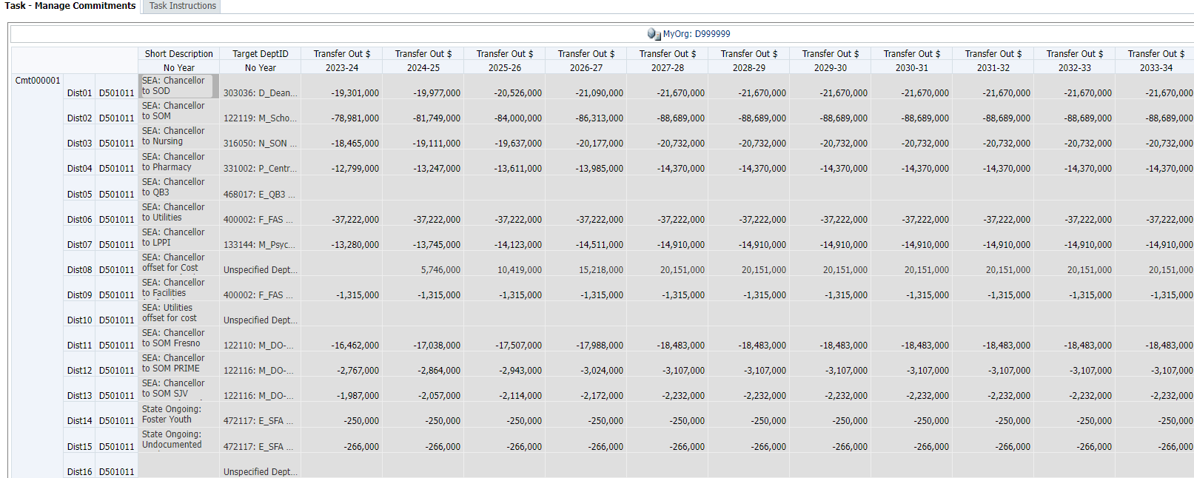
The Manage Commitments Landing Page Form lists all commitments in the MyOrg
POV: MyOrg DeptID
Columns: Short Description, Target DeptID and Transfer Out Dollars for 11 years
Rows: Commitments, Distributions and Source DeptIDs
Right-click (on Source DeptID) options include:
Add a Commitment
Add a Distribution
Edit Existing Commitment
Delete Commitment
Notes:
The Manage Commitments form is the “command central” of the Commitment Tracking module. You will use it to view a summary of your current commitments to other departments and to launch various actions to add, delete, or edit commitments.
After you have set your MyOrg DeptID, open the Manage Commitments Landing Page form. (If you try to open the form before setting the MyOrg variable, you will see an error message.) The Manage Commitments Landing Page shows the list of commitments and associated distributions for which the user’s DeptIDs are the Source DeptID.
Because the Manage Commitments form is a Landing Page, all cells are gray. No information can be entered or edited from this form. Here is a summary of the Manage Commitments form layout:
For more details on each of these fields, see the Data Elements section of this lesson.

Slide 22
MyOrg must be set in CommtPln in order to access forms
Set from Preferences > User Variables
If you select a planning DeptID, only commitments for that Source DeptID appear
If you select a higher-level DeptID, commitments for any Source DeptIDs below this MyOrg choice appear
You can change DeptIDs by changing MyOrg again in the Manage Commitments form
Notes:
You need to set your My Org to the Source DeptID for which you want to view their summary listing of commitments
Will only be able to view your own DeptID based on security access

Slide 23
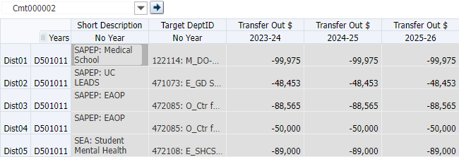
The Search Commitments form shows distributions for a single commitment
Commitment Number selected via the Page Filter
Right-click on the Source DeptID to edit the commitment or add a distribution
A new commitment cannot be added from this form
Notes:
You need to set your My Org to the Source DeptID for which you want to view their summary listing of commitments
Will only be able to view your own DeptID based on security access

Slide 24
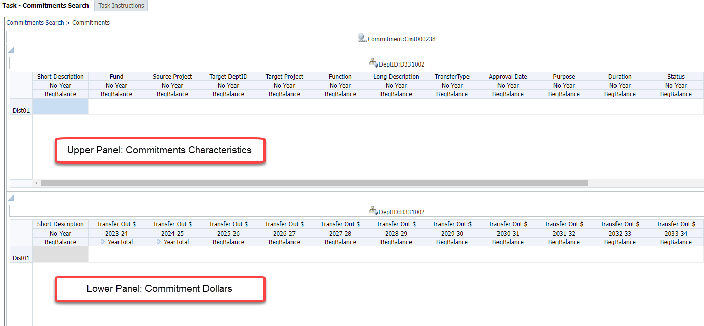
The Commitments data entry form is a composite form
The Source DeptID and the Commitment Number are shown in th POV
Rows are individual distributions
Notes:
The Commitment Data Entry Form allows users to make adjustments to all distributions within a commitment.
From the landing page, when you right click a commitment and select Edit Existing Commitment, the Commitment form appears, displaying the Source DeptID and the Commitment number in the POV.
The Commitment form is really a “composite form,” of two forms displayed as upper and lower panels, designed to reduce the amount of left-to-right scrolling.
In the upper panel, columns include all commitment characteristics.
In the lower panel, columns include the commitment dollar amounts by year. These are called Transfer Out Dollars.
The first two years, 2023-24 and 2024-25, can be planned at the month level. Later years can be planned on an annual basis. Also, the short description is shown on both the upper and lower panels, but can only be edited in the upper panel.
For both panels, the user can scroll left and right or up and down as needed.
Rows are all of the distributions for the commitment. Users may add or edit values for multiple distributions before saving. The right-click menu allows for distributions to be added or deleted.

Slide 25
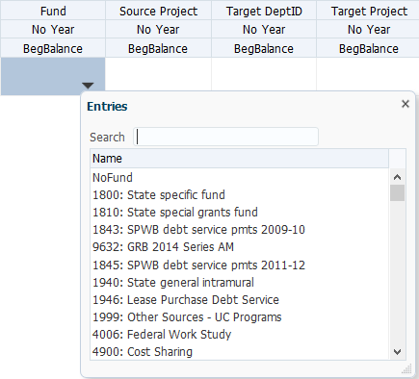
Many of commitment fields are Smart Lists and work like drop-down menus
To select a value for a Smart list field, click the down arrow to bring up the list
Type the ID or part of the description to help find your selection

Slide 26
The Commitment Tracking module includes 11 years in the Years dimension
Years includes the current year plus ten years
Current year and Plan Year 1 commitments can be planned at the month level
Important to match the commitment schedule to be consistent with the schedule of the actual financial transfers
At the beginning of each year, users will need to revise their plan year 1 data to match actual financial transfers
Planning for Years 2-10 is at the YearTotal level
Notes:
Year and Period
Year is the same as in General Planning, except that there are 11 years available for planning in the Commitment Tracking module: current year and ten years from the current year. You will enter data for Years as part of Transfer Out $ fields on the bottom half of the Commitment form. For the current year and Plan Year 1, commitments can be planned at the month level, while planning for Years 2-10 is at the YearTotal level.
As the years shift, users will need to revise their Plan Year 1 from the YearTotal to monthly planning to follow the planned schedule of actual financial transfers.

Slide 27
At present, the commitment module does not track actual transfers
Financial journals are submitted to PeopleSoft independently from UPlan
Planners should distribute commitments across months to avoid odd variance reports and forecasts
Match the UPlan commitment with the actual transfers in PeopleSoft
When the timing of the actual transfer varies from the commitment schedule, the forecast will be incorrect
Adjust (or ask the Source DeptID planner to adjust) the planned distribution in the Commitment Tracking module
Accept variance assuming it will be corrected in future
Notes:
Bring up R&E form: 332013 5130 1111111 shows all accounts
Spreading Transfer Out Dollars across Months
Notice that current year (in this case 2024-25) and Year 1 (in this case 2025-26) can be expanded. For the current year forecast and next year’s plan, in order to avoid odd variances in forecasts, users should make sure to distribute the money exactly as it will be transferred in financial journals. For example, if the entire commitment will be transferred in July, then do not enter the amount in YearTotal; enter the amount in July only. Also, remember that this does not replace the financial journal. Users will still need to complete financial journals separately and outside of UPlan.
When the timing of the actual transfer varies from the commitment schedule, the forecast will be incorrect. In these instances, planners can simply adjust the corresponding revenue account in the forecast to make up for the variance between transfer and commitment schedules. Alternatively, planners can adjust (or ask the Source DeptID planner to adjust) the planned distribution in the Commitment Tracking module.
Note: This only applies to Year 0 and Year 1. Planning in the Commitment Tracking module will not be by month for Years 2-10.

Slide 28
Source DeptIDs and Target DeptIDs should coordinate activity
A commitment with Approval Date will flow to Target DeptID’s Revenue and Expense form in Tfr account
Target DeptID should NOT enter this same planned transfer in a related COA account
Communication is key

Slide 29
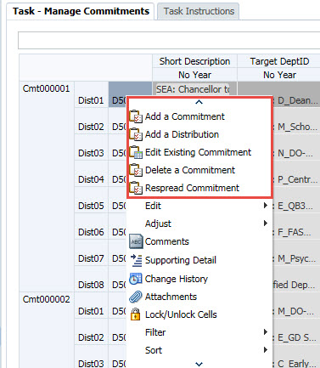
To add a commitment, use the right-click menu on the Manage Commitments form
When a commitment or a distribution is added, UPlan will update the Manage Commitments form
Once added, use the Edit Existing Commitment option to actually enter data elements
Notes:
You use the right-click menu to enter and edit information and data in Commitment Tracking. Here are the key options:
Add a Commitment
Add a Distribution
Edit Existing Commitment
Delete Commitment
When you are adding a commitment or a distribution for a commitment, UPlan will add this to the Manage Commitments form. Once you have added them, to actually enter data elements for these commitments, you will be using the Edit Existing Commitment option

Slide 30
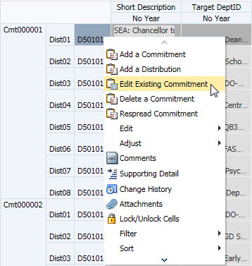
To edit a commitment, right-click on the Source DeptID from either landing page
Select the Commitment Number you want to edit
Right click on the source DeptID
and select Edit Existing Commitment
Notes:
The Edit Existing Commitment option is important. Not only do you use it when you want to change a saved commitment with information, but also to populate fields for a newly added commitment or distribution.

Slide 31
A new distribution can be added from any of the forms
Right-click on the Source DeptID for the intended commitment and select Add a Distribution
The new Distribution will be added below the last distribution in this Commitment, with the next distribution number
If you added the Distribution from the Manage Commitments or Commitment Search forms, right click on the Commitment and select Edit Existing Commitment
If you added the Distribution from the Commitments form itself, you can begin entering data immediately
Notes:
You can add a new distribution from either of the two forms: Manage Commitments or Commitment form. The new distribution ID will be sequential. For example, the first time you add a new distribution, it will be Dist02. (Dist01 is always created when you add a new commitment.)

Slide 32
A commitment can only be deleted from the Manage Commitments form
Right click on the row for the Commitment Number you want to delete and select Delete Commitment
When the warning prompt appears, click OK
Notes:
If you discover that you no longer need a commitment, you can delete it from the form. All of the distributions associated with it will be removed as well. The change will also flow through to General Planning.

Slide 33
Other Commitment Tracking Topics

Slide 34
Cascading Commitments (Allocations)
Prior to UPlan:
Permanent budget tracked allocations of various funds (e.g. State Educational Appropriation and Campus Core Funds) to specific Fund/DPA combinations
Entries were like allocations directly from the Chancellor to specific units
In the UPlan: some allocations flow or “cascade”:
Chancellor → Control Points → Depts → Divisions
Known alternately as cascading commitments or cascading allocations

Slide 35
In UPlan, some allocations flow to departments as cascading commitments
Commitment 1:
BRM allocates
to Control Point
Use of cascading allocations enables each level to adjust commitments on its own without involving higher levels
Commitment 2:
Control Point allocates
to Department
Commitment 3: Department allocates
to Division
Non-recurring allocations for specific purposes/activities generally o not entail cascading commitments
Division plans expenses

Slide 36
Example: Cascading Allocations of State Funds
CommNum | Cmt000001 | Source DeptID |  | 501011 | W_CFP Plan
DistNum | Short Description | Fund | Source Project | Target DeptID |  | Target Project | Amount 2013-14 | Amount 2014-15 | Amount 2015-16
Dist01 | SEA: Chancellor to SOD Dean | 1900 | 1111111 | 303036 | D_Dean's Ofc Administration | 1111111 | 60,000,000 | 61,800,000 | 63,654,000
Dist02 | SEA: Chancellor to SOM Dean | 1900 | 1111111 | 122105 | M_DO-CA-OP-Admin-Financial Aff | 1111111 | 10,000,000 | 10,300,000 | 10,609,000
Dist03 | SEA: Chancellor to SON Dean | 1900 | 1111111 | 316002 | N_DO-Administration | 1111111 | 10,000,000 | 10,300,000 | 10,609,000
Dist04 | SEA: Chancellor to SOP Dean | 1900 | 1111111 | 331002 | P_Central Administration | 1111111 | 10,000,000 | 10,300,000 | 10,609,000
Total |  |  |  |  |  |  | 90,000,000 | 92,700,000 | 95,481,000
CommNum | Cmt000019 | Source DeptID |  | 303036 | D_Dean's Ofc Administration
DistNum | Short Description | Fund | Source Project | Target DeptID |  | Target Project | Amount 2013-14 | Amount 2014-15 | Amount 2015-16
Dist01 | SEA: SOD Dean to Peds | 1900 | 1111111 | 301006 | D_Pediatric Dentistry | 1111111 | 1,200,000 | 1,200,000 | 1,200,000
Dist02 | SEA: Craniofacial Anomalies | 1900 | 1111111 | 301009 | D_Craniofacial Anomalies | 1111111 | 1,800,000 | 1,800,000 | 1,800,000
Dist03 | SEA: Orthodontics | 1900 | 1111111 | 301012 | D_Orthodontics | 1111111 | 1,750,000 | 1,750,000 | 1,750,000
Dist04 | SEA: Oral Pathology | 1900 | 1111111 | 301015 | D_Oral Pathology | 1111111 | 310,000 | 310,000 | 310,000
Dist05 | SEA: Periodontology | 1900 | 1111111 | 301018 | D_Periodontology | 1111111 | 1,675,000 | 1,675,000 | 1,675,000
Dist06 | SEA: Oral Medicine | 1900 | 1111111 | 301021 | D_Oral Medicine | 1111111 | 1,465,000 | 1,465,000 | 1,465,000
Total |  |  |  |  |  |  | 8,200,000 | 8,200,000 | 8,200,000
CommNum | Cmt000021 | Source DeptID |  | 316002 | N_DO-Administration
DistNum | Short Description | Fund | Source Project | Target DeptID |  | Target Project | Amount 2013-14 | Amount 2014-15 | Amount 2015-16
Dist01 | SEA: CHS-Glide | 1900 | 1111111 | 318008 | N_CHS-Glide | 1111111 | 2,500,000 | 2,575,000 | 2,652,250
Dist02 | SEA: Physiological Nursing | 1900 | 1111111 | 319008 | N_Physiological Nursing | 1111111 | 2,745,000 | 2,827,350 | 2,912,171
Dist03 | SEA: Social Behavior Sciences | 1900 | 1111111 | 320010 | N_Social Behavioral Sciences | 1111111 | 3,244,000 | 3,341,320 | 3,441,560
Dist04 | SEA: Inst for Health Aging | 1900 | 1111111 | 321012 | N_Institute for Health Aging | 1111111 | 1,511,000 | 1,556,330 | 1,603,020
Total |  |  |  |  |  |  | 10,000,000 | 10,300,000 | 10,609,000

Slide 37
Signage on the Commitment Tracking data entry form is reversed
Source DeptID is: | Landing Page and Reports* | Data Entry Form
Giving money away | – | +
Taking money back | + | –
Target DeptID is: | Reports*
Losing money | –
Receiving money | +
* Same as in General Planning

Slide 38
Commitment Tracking Reports

Slide 39
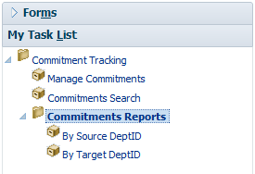
Two form reports provide data based on the MyOrg selection
The By Source DeptID report shows all commitments from units within the MyOrg
The By Target DeptID report shows all commitments being received by units within the MyOrg
Both reports provide all data elements
To export to Excel, use the Tools menu

Slide 40
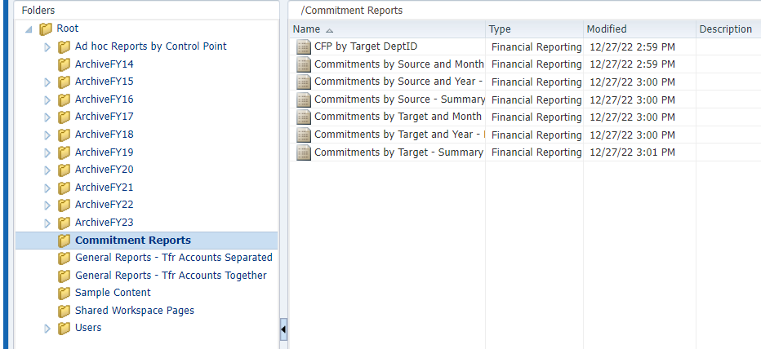
Commitment Tracking reports are also found in Hyperion FR Reports (Explore)
These reports will only run for one planning-level DeptID at a time

Slide 41
These reports provide more limited data
Report Title | Description
Commitments by Source (or Target ) – Summary | List of individual commitments provided by (or received by) a particular DeptID Shows total commitment amount of 11-year period
Commitments by Source (or Target) and Year – Detail | List of individual commitments provided by (or received by) a particular DeptIDs Shows year total amounts for current year plus 10 years of commitments
Commitments by Source (or Target) and Month – Detail | List of individual commitments provided by (or received by) a particular DeptID Shows amounts by month for either the current year or the next year

Slide 42
Review Quiz!
1. True or False?
a) | A commitment is a planned financial transfer | True | False
b) | If I set MyOrg in the UPlan, it will automatically set in Commitment Tracking | True | False
c) | Each commitment I enter will create an automated financial journal | True | False
d) | In addition to the current year, I can plan 10 additional years of commitments | True | False
Notes:
True
False – Set separately
False – Still need to set up the financial journal
True – True, Year 1 at a monthly level; Years 2 – 10 at an annual level

Slide 43
2. Which fields are required for Commitment to show in Target DeptID in General Planning?
Commitment Number
Distribution Number
Fund
Source DeptID
Source Project
Target DeptID
Target Project
Short Description
Long Description
Function Code
Start Date
End Date
Transfers Out (Dollars Amounts)
Transfer Type
Purpose
Duration
Status
Contingency Flag
Authorizer
Requester
Approval Date
Date of Request
Notes:
Answer:

Slide 44
Answers to Commitment Tracking Quiz
True or False:
True
False
False
True
Planners for the Target DeptID will see the commitment in General Planning if it has a Target DeptID, Target Project, Fund, TransferType, and Approval Date

