Slide 1
UPlan Employee Planning
Budget & Resource Management
Spring 2021

Slide 2
© [2020-2021] “University of California San Francisco (UCSF)”
Ownership of Copyright
The copyright in this material (including without limitation the text, artwork, photographs, and images) are owned by UCSF.
Copyright License
UCSF grants to you a non-exclusive royalty-free revocable license to:
- View this material on a computer
- Store this course in your cache or memory
- Print pages or material from this course for your own personal and non-commercial use.
All rights reserved.
Enforcement of Copyright
UCSF takes the protection of its copyright very seriously. If UCSF discovers that copyrighted materials have been used in contravention of the license above, UCSF may bring legal proceedings against you seeking monetary damages and an injunction to stop you from using the materials.

Slide 3
Contents
Employee Planning Overview and Concepts
Individual Employee Forms
Multi-Employee Forms
To-be-hired (TBH) Forms
Global Assumptions and Seeding
Employee Form Reports
Other Employee Topics

Slide 4
Employee Planning Overview and Concepts

Slide 5
Employee Planning Features
UPlan module allows detailed salary planning for:
Individual employees
To-be-hired (TBH) employees or reductions for an individual or group
Data fed from UCPath
To avoid duplicative work
For each employee and TBH, users can:
Adjust the salary and benefit levels
Distribute salary and benefits costs across DFPs on a monthly basis
Identify sources of funds to cover the NIH OTC amount
Employee Planning is enabled for the same timeline as General: current year Forecast (Year 0) and the next two fiscal years’ Plan (Years 1, 2)

Slide 6
Employee Planning Features (continued)
Salary levels can be adjusted across two pay components, which are mapped by Earnings (ERN) Codes:
Base and Negotiated salary
Additional salary
Benefits are adjusted by increasing or decreasing benefit rates
Users can distribute salary and benefit costs for each pay component across multiple DFP’s
By planning at the individual employee level, you can:
Plan for employees within your home department
Plan for other employees that your planning department funds
Reminder:
Non-planning home departments were mapped to planning departments
These planning departments plan salary levels for employees

Slide 7
Salary and benefit levels are planned by the equivalent of the home department
Because UCPath primary jobcode DeptIDs may not be planning DeptIDs themselves, employees are mapped from primary jobcode DeptIDs to Salary Level Planning DeptIDs based on Control Point and department input
Pay distributions are planned by the paying department
The following table summarizes the relationships between the PPS DeptID terminology and the UPlan DeptID terminology:
In PPS | In UPlan | Notes
Primary Job Department: Each employee has one Primary Job Department in UCPath that manages employee data, salary levels, etc. | Salary Level Planning Department: Plans employee salary and benefit levels in UPlan. Each employee is assigned to one and only one Salary Level Planning Department. | These may be the same, but only if the UCPath Primary Department is a planning department in UPlan.
Payroll Department: Any number of departments may provide funds to cover an employee’s salary and benefits. | Planning Payroll Department: Any number of departments may plan funds to cover an employee’s salary and benefits. | These may also be the same, but only if the payroll department is a planning department in UPlan.

Slide 8
Planning is enabled for two Pay Components
Each employee’s compensation can be comprised of many payroll components (ERN codes)
UPlan maps ERN codes from UCPath into two pay components:
Exclusions include ERN codes that are inactive or have no pay/expense associated.
Salary Component | Faculty Salary and Benefits | Non-Faculty Academic/Staff Salary and Benefits
Base & Negotiated | Includes X and X' portion of faculty salary (Health Sciences Compensation Plan) as well as credits that impact base pay Includes Y portion of faculty salary (Health Sciences Compensation Plan) | Includes regular salary and those salaries that are treated like regular pay as well as credits that impact base pay.
Additional/Other | Includes all salary not included in the X and Y components of faculty salary. | Includes all non-base salary, such as shift differentials and overtime.

Slide 9
Results are sent to General Planning in three employee groups
Employees are grouped based on Job Codes:
Faculty Academic (5000C: Faculty salaries, 5010C: Faculty bonuses & incentive, 5030C: Faculty benefits)
Non-faculty Academic (5020C: Non-faculty academic salaries, 5040C: Non-faculty academic benefits)
Staff (5050C: Staff salaries and overtime, 5060C: Staff benefits)

Slide 10
What is not included in Employee Planning?
Employee Planning is based on total compensation in each month
UPlan does not include functionality for planning hourly pay
UPlan does not address bi-weekly pay dates or hire anniversary dates (identifying merit or end dates)
UPlan does not currently address non-NIH salary caps
Planners will need to track salary cap funding manually
Employees whose home department or funding department belongs to the Medical Center

Slide 11
Users can plan at the employee level for Year 2 or use Adjustment accounts
Employee Planning allows planning for Year 0 (current year), Year 1, and Year 2
Planners can make adjustments at the DFP level in the General Planning module for Year 2

Slide 12
External Data Integration
Data fed from UCPath
New employees
Employee ID, job codes, and salary rate level loaded nightly
Salary rate level
Base and negotiated (Base&Neg) salary level updates when a month closes and populates forward for open months
Benefit rate level
Actualized at every month close and populates forward to open months
Distributions percentages, and salary and benefits $
Actualized at every month close but does not carry forward to open months
Notes:
Note: Faculty Portfolio TBHs are not unique, meaning multiple departments can use TBH01. UPlan does have unique TBHs. Aggregating will greatly reduce the number of TBH’s from FP.

Slide 13
Employee Planning Business Process
There is no single, correct way to approach your forecasting and planning for Employee Planning
Each Control Point will have different guidelines for their planners, within which there are many options regarding the order of planning tasks
The following graphic helps give you a visual perspective on Employee Planning
Each large block represents activities to be addressed. Notice there are no arrows connecting these blocks to convey that you are not required to proceed in any exact order.

Slide 14
Employee Planning includes three sets of planning forms along with reports and other functionality on the Task List
Folder | Forms
Individual Employee Forms | Search Individual Employees Employee Landing Page NIH OTC Forms (temporarily unavailable)
Multi-Employee Forms | Multi-Employee Salary and Benefit Levels Multi-Employee Distribution Percentages
TBH Employee Forms | Search Individual Employees TBH Employee Landing Page
Empl Global Assumptions | Salary Global Assumptions Benefits Global Assumptions
Empl Seeding Options | Forecast - Benefits Level Forecast - Distribution Pct % Year 1 - Salary Level Year 1 - Benefits Level Year 1 - Distribution Pct % Year 2 - Salary, Benefits, and Dist Pct %
Empl Reports | Compensation Detail by DFP Multi-Empl Distr Pct and $
Push Empl Data to General

Slide 15
Individual Employee Forms

Slide 16
Search Individual Employee form allows data entry for a single employee
Page Filter contains the list of Employees
Medical Center employees not included
Five tabs, columns same as Rev & Exp form except summary on tab 5
YearTotal for %
Reflects the last month that contains a value. This feature is called “time-balance-last”.
All tabs include DeptID and Job Code as rows
Other rows for Salary Component, Fund and Project may be included depending on the tab

Slide 17
Tab 1 (Empl Salary) allows for updates to the salary levels by component
For Base & Negotiated (Base&Neg) Salary:
Both the initial monthly salary and the global assumption are displayed
Planners can either:
override the global assumption with another percentage adjustment
simply enter a new monthly salary amount, which takes precedence over the adjustments above
The resulting monthly salary is then shown, which carries forward as the initial salary in the next month
For other salary components, planners simply enter the appropriate values

Slide 18
Tab 1 (Empl Salary & Benefits) allows for updates to the salary levels and adjustments to benefits rates by salary component

Slide 19
Rows: Employee Salary Level Data
Rows (Accounts) | Description
Initial Base&Neg Salary | Base and Negotiated Salary amount at the beginning of the period, before any salary adjustments are made
Global Assumptions % | Salary increase percentage based on the global assumption for the Union Code to which the Employee belongs
Override Global % | Salary driver to override the global assumption for base and negotiated salary increase for this employee/job code combination
Global Assumptions Impact $ | Calculated dollar amount of the Global Assumptions % or the Override Global %
Salary Level Override | Base and negotiated salary level entered by planner to override initial base and negotiated salary amount and percentage increases. When a forecast month closes, this field is trued up with the salary level from UCPath and carries forward to the next month.
New Base&Neg Salary | Ending base and negotiated salary calculated based on above salary driver accounts (read-only)
Addtl Salary | “Catch-all” salary component that includes other Earnings codes not applied to Base or Negotiated Salary. Examples include stipends and overtime.
Ending Total Salary | The sum of New Base&Neg Salary, Addtl Salary, and Non-UCSF Pay.

Slide 20
Rows: Employee Benefits Level Data
Rows (Accounts) | Description
Benefits (%) | Seeded/calculated estimate of benefits rate for base and negotiated salary (read-only) Rate in Forecast = Planning CBR %, however, rate in Actuals = CBR + VLA + UCRP Supplemental Interest. This % rolls forward into open forecast and overrides the Planning CBR %. The Planning CBR % is brought into the Forecast nightly, and will eventually be brought into the Plan The planning rate is slightly lower than the real CBR charged to the department to account for the VLA credit to the department when the employee takes vacation For HCOMP-eligible employees, the Benefits % includes the 1% Faculty childbearing/childrearing assessment
Benefits Adj (%) | Planner-entered override the Benefits % account if there is a value in the cell, and calculates on the “New Base&Neg Salary” account (writable)
Benefits ($) | Dollar amount of benefits for base and negotiated salary (read-only)

Slide 21
The new base and negotiated salary is calculated based on the four rows above
 | Row | Jul | Aug | Sep | Oct | Nov | Dec
(A) | Initial Base&Neg Salary | $100,000 | $100,000 | $104,000 | $104,000 | $110,000 | $110,000
(B) | Global Assumptions % |  | 3%
(C) | Override Global % |  | 4% |  | 5%
(D) | Salary Level Override |  |  |  | $110,000
(E) | New Base&Neg Salary | $100,000 | $104,000 | $104,000 | $110,000 | $110,000 | $110,000
 |  | (1) | (2) | (3) | (4)
Because rows B, C and D are blank, the new salary equals the initial salary
Row C takes precedence over Row B, and therefore the salary increases by 4%
Note that the ending salary for the prior month becomes the initial salary for the current month
Row D takes precedence over Row C, and therefore the salary changes to $110,000

Slide 22
Empl Benefits allows adjustments to benefits rates
The individual’s benefits rates as estimated by the system based on seeded/calculated estimate of benefits rate for base and negotiated salary or actuals are displayed
Planners may then override the benefits percentage
To adjust the Benefits %, enter the new rate to Benefits Adj %
The form also displays the calculated benefits amounts based on either the original or adjusted benefits rates
Note: Benefit % in Actuals carries forward into open forecast and overrides the Planning CBR %

Slide 23
Tab 2 (Empl Distr Pct) allows adjustments to pay distributions by salary component
Rows include (paying) DeptID, Fund, and Project
All actual or planned DFP combinations are displayed
Totals by Job Code and Salary Component are displayed at the bottom of the form
Values do not carry-forward from one month to the next, so planners must copy adjustments to future months
Write access is provided based on planner security settings
Planners may only add or adjust distributions for DeptIDs they own
To add or delete a distribution, right-click on the Project field and select Add Distribution

Slide 24
Tab 2 (Empl Distr Pct) allows adjustments to pay distributions by salary component

Slide 25
The time-balance-last feature for the YearTotal column on Tab 2 Empl Distr Pct
Since all the values are percentages, the YearTotal column will display the last non-missing monthly value
For example, if June contains a percentage, the June value will appear in the YearTotal
If June does not contain a percentage, but May does, the YearTotal column will display the May value
Data entered in the YearTotal column will spread to all months if there is no data in any months
Otherwise, the value entered will populate June only
Best Practice: Expand YearTotal

Slide 26
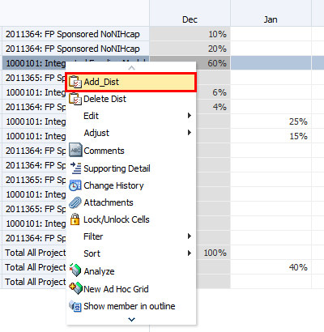
To add a DFP distribution, right-click anywhere in the tab workspace
Click Add Dist
Hint: right-click on the Project in a row that is most similar to the row you want to add

Slide 27
Then, use the prompt to select the Job code, Pay Component, DeptID, Fund and Project
Click the Member Selection icon to change selections for each dimension
If you followed the hint on the prior slide, you will have fewer changes to make
When you have finished filling in all fields, click Launch button

Slide 28
Tabs 3 and 4 display the dollar amounts of planned pay distributions by DFP
Tab 3 (Empl Distr Sal $) shows the distributed salary amounts
Tab 4 (Empl Distr Ben $) shows the distributed benefits amounts

Slide 29
Tabs 3 and 4 display the dollar amounts of planned pay distributions by DFP (cont’d)
These forms are read-only and not writable
Totals by Job Code and Pay Component are displayed at the bottom of the form
Values on these tabs are updated once salary levels, benefit rates or distribution percentages on other tabs are saved/submitted

Slide 30
Tab 5 (Empl Summary) contains summary information about the employee
In addition to Job Code and (home) DeptID, rows include various employee characteristics
If desired, planners can update values for Rank, Step, and FTE
Other values are calculated based on Base&Neg salary level from Tab 1 Empl Salary

Slide 31
Rows: Employee Summary Page Data Form
Rows (Accounts) | Description
Rank | Smart List indicating a job code’s rank (only applicable to some faculty and non-faculty academics titles). Choices are: NA, FULL, ASSOC, ASST, INSTR. This is informational only and is not used in calculations.
Empl Grade_Step | Smart List, with a drop down box giving you choices for grades or steps. For employees with no grade or step, select NoGradeStep. This is informational only and is not used in calculations.
FTE | Full Time Equivalent; enter 1.0 for Full time; 0.5 for half time, etc. This is informational only and is not used in calculations.
Beginning Total Salary | New Base&Neg Salary Level at the beginning of the period (July)
Ending Total Salary | New Base&Neg Salary Level at the end of the period (June)
Ending Salary Variance $ | Year-over-year dollar change in Ending Total Salary
Ending Salary Variance % | Year-over-year percentage change in Ending Total Salary

Slide 32
The Employee Landing Page lists all of the employees in a selected MyOrg
Displays a roster of current employees owned by the DeptIDs in the MyOrg selection
Rows are (home) DeptID, Employee, and Job Code
Columns include current year and Year 1 with additional account detail
Provides a bird’s-eye view of employees and their compensation information
Data cannot be edited (gray cells)
Right-click on a Job Code to go to the data entry form for the corresponding employee

Slide 33
Columns: Employee Landing Page
Columns (Accounts) | Description
New Base&Neg Salary | Year-total base and negotiated salary level planned
FTE | Full Time Equivalent value for the Employee/Job Code intersection
Base&Neg Dist (%) | Total percentage of Base and negotiated salary planned for June
[FTE-Base&Neg Dist%] | Difference between the FTE value and the total percentage of Base and negotiated salary planned for June; a non-zero value indicates that either the FTE value or the planned distributions are incorrect

Slide 34
Multi-Employee Forms

Slide 35
The Multi-employee Salary and Benefit Level form covers base and negotiated compensation
Rows include (home) DeptID, Employee and Job Code
Only certain base and negotiated salary and benefit accounts are shown:
Account | Use
Initial Base&Neg Salary | Read-only
Salary Level Override | Enter the corrected salary value to override the Initial Base&Neg Salary
Benefits (%) | Read-only
Benefits Adj (%) | Enter the benefits adjustment percentage for each month to override the Benefit (%)
Benefits ($) | Read-only

Slide 36
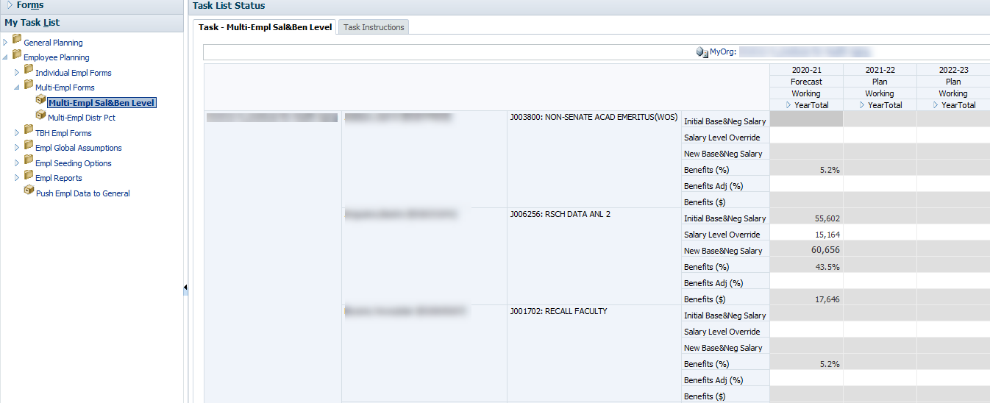
Layout of Multi-employee Salary and Benefit Level

Slide 37
The Multi-employee Pay Distribution form is similar to tab 3 of the individual employee form
Rows include Employee, Job Code, Salary Component, DeptID, Fund, and Project
Displays only employees with Home DeptIDs in your MyOrg
An employee cannot be added
Add and delete distribution functionality works similarly to the Individual Employee form
Hint: You can make changes for multiple employees and submit (save) the data to UPlan when you are finished
Except, if you are going to add or delete distributions, you should submit/save any changes you have made up to that point

Slide 38
Layout of Multi-employee Distribution Form

Slide 39
To-Be-Hired Employee Forms

Slide 40
A To-Be-Hired Employee is a provision for a new hire(s) or salary savings
A line item that shows expected plans
Provisions for planned new hires
Negative provisions for salary savings
These provisions may be individuals or groups and job code may or may not be specified
NoTitleCode rolls up to Staff (Union Code 99)
Almost identical to Individual Employee forms
Salary level may be planned across salary components
Benefits rates can be adjusted
Salary and benefits can be distributed for each salary component across multiple DFPs

Slide 41
TBH forms have a few differences
The TBH Landing Page lists the to-be-hired provisions created within your MyOrg
The Search TBH Form is where you modify data about your TBHs

Slide 42
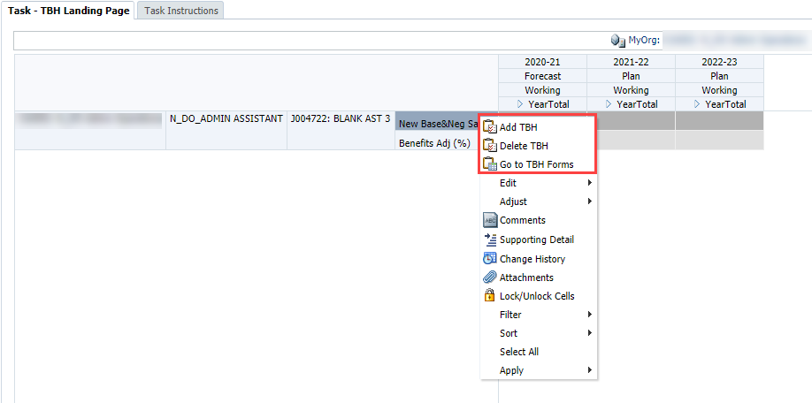
The TBH landing page is where you add new to-be-hired provisions
To add a TBH, right-click on the right-most row header and select Add a TBH
If no rows are currently displaying, right-click on the missing row-header
Similarly, to delete a TBH or adjust data for a TBH, right-click on the right-most row header for the TBH you want to delete or adjust

Slide 43
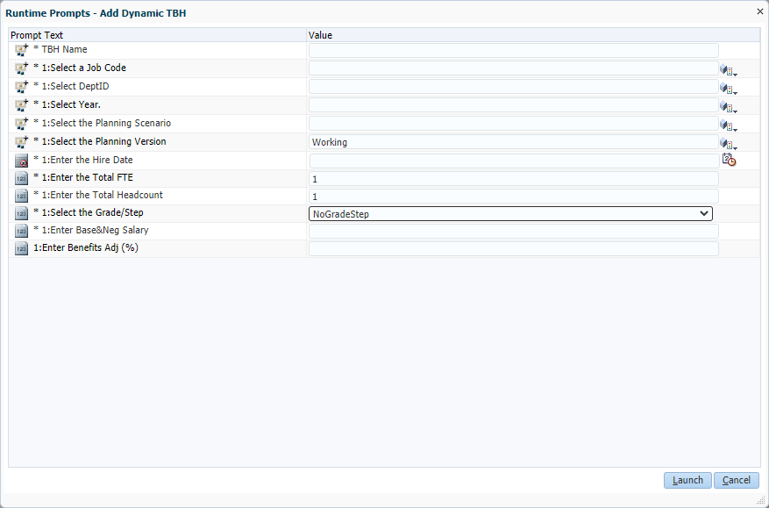
To add a TBH, use the right-click menu from the TBH landing page
After selecting this option via the right-click menu:
Prompt box opens to create the TBH provision
Fields with Asterisks (*) are required to create a new TBH

Slide 44
Data Elements for Adding a TBH
Field | Details
Name | Enter the unique name
Salary Level Planning DeptID | Enter the Home DeptID, preceded by the letter “D”; must be a planning-level DeptID
Year | Enter the specific fiscal year for the Forecast or Year 1 (e.g. FY21 or 2020-21)
Planning Scenario | Enter “Forecast” or “Plan”
Planning Version | Enter Working (only option available)
Job Code | Select a specific Job Code; the code must be preceded by the letter “J” Select NoTitleCode to plan for many employees with different job functions or if you don’t yet know what the job code will be Note that “NoTitleCode” flows to General Planning “staff” salary and benefit accounts upon integration
Hire Date | Enter a date in the format M/D/YY or use the calendar look-up feature The data entered will prepopulate the months for the salary rate level, benefit rate level, and DFP distributions. For example, if the planning scenario is Forecast and 3/1/21 entered as the hire date, March-June of the Forecast will pre-populate.
Total FTE (Full Time Equivalent) | Enter 1 for a specific individual full time requisition More than one headcount can equate to one full time equivalent employee (e.g. you can have 1 FTE but 2 headcount if TBH represents 2 part-time provisions) Type a decimal for one part time hire (such as .50 for one half time) Type a whole number greater than 1 to indicate group provisions; can be multiple full time or part time individuals, and it can be for similar job codes or generic job codes
Total Headcount | Enter the number of individuals this FTE entry represents
Grade or Step | Defaults NoGradeStep; selections can be made from the dropdown list
Base&Neg Salary | Enter a whole number (with no commas) Enter the annualized salary; the monthly amount is pro-rated based on hire date entered If TBH is a group provision, the value should be combined total base and negotiated salary of the FTE and headcount (e.g. 5 FTE/headcount @ $50,000 = $250,000)
Benefits Adj % | Enter the percentage benefits rate to be applied to the base and negotiated salary Simply enter the value without formatting. Do not use the % sign or the decimal. For example, if you want to enter a 15% benefits rate, simply enter 15, not 15% or 0.15.

Slide 45
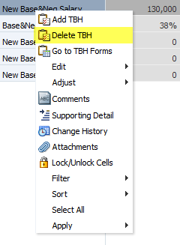
To remove a TBH, also use the right-click menu from the TBH landing page
Why remove a previously-entered TBH?
Employee(s) have been hired for this position
No longer need to hire anyone for this position
Right-click menu from Landing Page, choose Remove a TBH
Prompt will warn you

Slide 46
Planners can leverage the TBH forms to plan for a group of employees
Examples:
Include a line item for five new faculty recruitments
Plan for twenty new half-time staff employees
Add a “dummy” TBH that covers the expected salary and/or benefit increases for the entire DeptID

Slide 47
TBH provisions should be named following DeptID hierarchy protocol
Unique TBH identification numbers removed
Some still around; can delete and replace with unique names
Unique names still required. Some examples:
SOD TBH Provisions: “D_M_Residents”
SON TBH Provisions: “N_OSA_TA_2312”
SOP TBH Provisions: “P_CP”
FAS TBH Provisions: “F_RE_Assets&Dev Operating Analyst 5”
EVCP TBH Provisions: “E_VCR”
CO TBH Provisions: “C_VCDO”
UDAR TBH Provisions: “V_U16_516302_Project Manager”
UR TBH Provisions: “R_MR”

Slide 48
Global Assumptions and Seeding

Slide 49
Salary Global Assumptions are set by BRM, Level 1 and 2 Coordinators
Budget and Resource Management office (BRM) initially sets global assumptions only for salary increases
These assumptions are based on information from Human Resources
Level 1 and 2 Coordinators can adjust salary global assumptions by Union Code for their control points and departments
Global assumptions apply to base and negotiated salary only
Planners may use the Override Global % field on the Salary Level form
Planners may use salary and benefit adjustment accounts in General Planning to make changes for these expense categories for Year 2
Global Assumptions do not apply to TBH provisions during Year 2; salary and benefits carry forward without any adjustments
Notes:
In Employee Planning, Level 1 and 2 Coordinators can set global assumptions by Union Code for their control points and departments. In Year 1 (2021-22 Plan), the percentages apply to base salary only. Global assumptions are automatically applied.
Planners can use the Override Global % field to supersede the global assumptions. When you enter a value in Override Global % for an existing employee, it will apply this new increase or decrease to the original base salary even after it was seeded and global assumptions were applied to it.
In Year 2 (2022-23), global assumptions will apply to all salary components (base salary, negotiated salary, Faculty Bonuses/Incentives and Additional/Other Salary). Planners cannot adjust Year 2 plan data at an individual employee level. Beyond global assumptions, planners must use salary and benefit adjustment accounts in General Planning to make changes for these expense categories for Year 2.

Slide 50
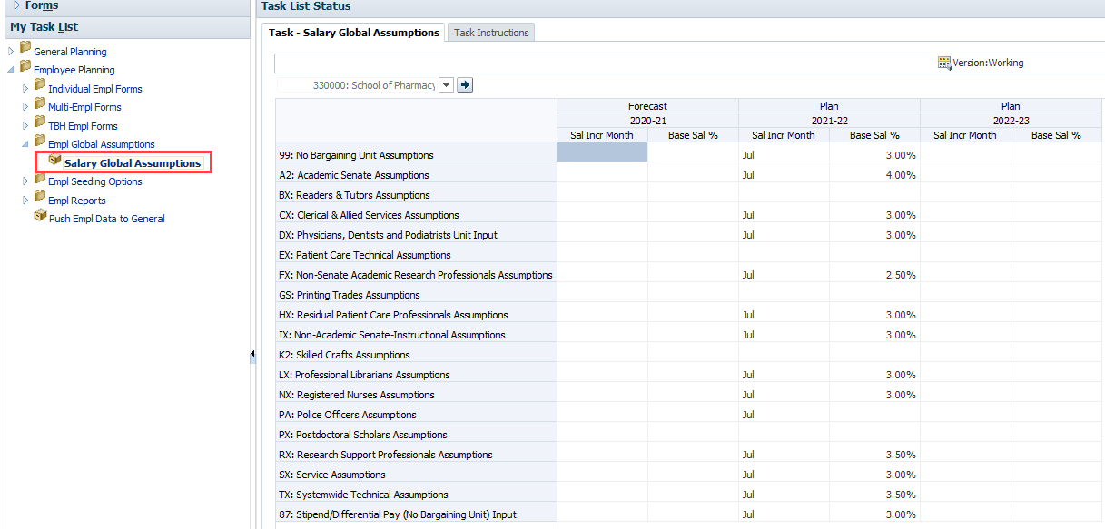
Salary Global Assumptions Form
Notes:
Only Coordinators have the ability to adjust the Global Assumptions form, and only at the Level 1 and Level 2 levels of the DeptID tree.
Planners can view the global assumptions on the Employee Global Assumptions Form. Then, if they want to make a change to the increase (or decrease) for an individual, they can use the Override Global % field on the Employee Level Salary Plan Form.

Slide 51
Responsibilities in Employee Planning
Role | Actions
UPlan Administrator (BRM) | Sets initial global assumptions
Level 1 Coordinator | Adjust global assumptions for all departments within the control point
Level 2 Coordinator | Adjust global assumptions for all DeptIDs within the department
Planner | Seed Year 1 plan with global assumptions; adjust Year 1 Plan; global assumptions can be overridden for base and negotiated salary at the individual employee level (Override Global % field)
Planner | Seed Year 2 Plan for salary and benefits that will automatically populate Revenue & Expense Form in General Planning Module

Slide 52
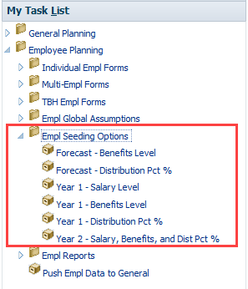
In Employee Planning, planners may seed for the forecast, Year 1, and Year 2
Separate rules exist for salary levels, benefits rates, and pay distributions
Planners will need to carefully consider which rule to apply and timing of when to apply.
In most cases, your control point will provide guidelines on timing

Slide 53
July base and negotiated salary levels can be seeded from any source month
Seeding salary levels not required for the Forecast
Applies to base and negotiated salary only
Seeds initial (July) salary levels for the Year 1 Plan by MyOrg DeptID
Planner selects the Source Month, Year, Version and Scenario
In most cases, planner should select June of the current year as the Source Month to be applied to July of Year 1

Slide 54
Separate rules are available for seeding benefit rates in the Forecast, Year 1, and Year 2
For the current year forecast, planners may choose to seed from any month (open or closed) during Year 0
Data is pre-populated with the prior year’s Plan Final at the beginning of the fiscal year
Seeding applies only to open months (non-actualized) of the Forecast
For the Year 1 plan, planners may choose to seed from any month of the Forecast
Global assumptions will apply
Populates all months of the Year 1 Plan
For Year 2 plan, the rule is combined with seeding the salary rate and DFP distributions

Slide 55
Planners can seed DFP pay distributions for the Forecast, Year 1, and Year 2
These rules apply to pay distributions for non-FP projects
For the current year forecast, planners may choose to seed from any month (open or closed) from the forecast
Applies only to open months (non-actualized) of the Forecast
For the Year 1 plan, planners may choose to seed from a single month of the Forecast or Year 1
In most cases, planners should choose to seed from June of the current year Forecast

Slide 56
Employee Form Reports

Slide 57
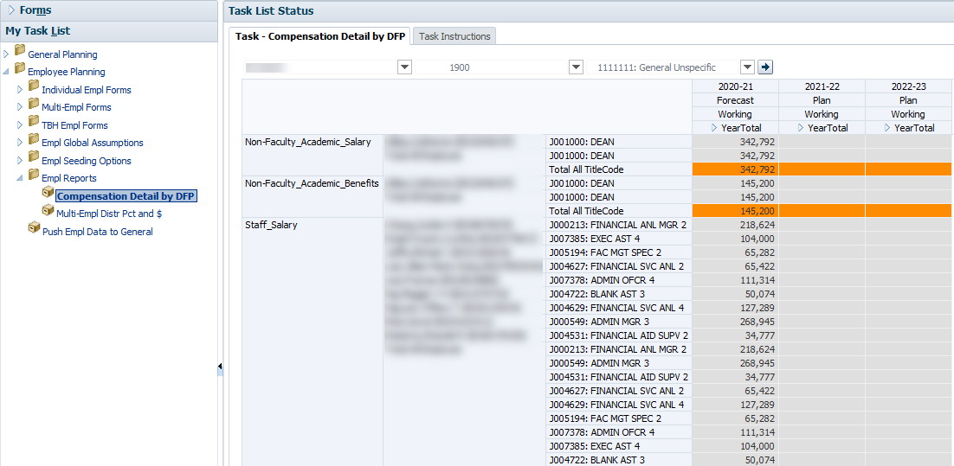
Two Employee Reports Available (more may be added in the future)
Compensation Detail by DFP
Shows the details of employees funded by a specific DFP
Can be accessed in Employee Planning > Empl Reports folder
Can be accessed in General Planning > Revenue and Expense forms > right-click on ProjectID in row
Allows navigation to the Search Individual Employee form

Slide 58
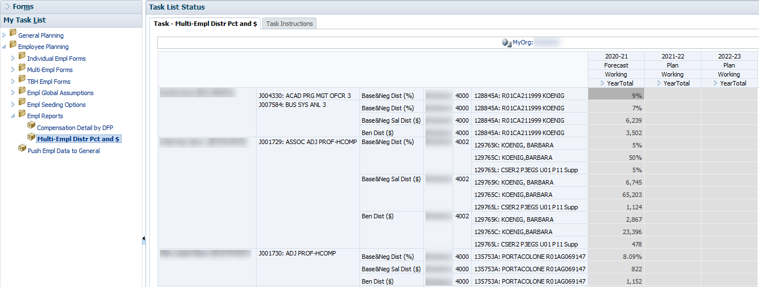
Two Employee Reports Available (more may be added in the future)
Multi-Empl Distr Pct and $
Shows the DFP distribution percentages and calculated distribution dollars for salary and benefits for employees under the selected MyOrg DeptID
Allows navigation to the Search Individual Employee form

Slide 59
Other Employee Topics

Slide 60
Employees with a UCSF Health home department are not included in UPlan
In addition, distributions funded by UCSF Health will not be loaded to UPlan
If your department funds a UCSF Health employee
Create a TBH
If UCSF Health funds one of your employees
Do nothing; the medical center is not using UPlan

Slide 61
Benefits for Fellows and Residents with No Salary
Postdocs who have no salary, but do have benefits:
They will appear on the employee roster but no ability to plan benefit rate
Pending possible enhancement
Use the benefits adjustment accounts in Revenue & Expense form in General Planning to add benefits

Slide 62
Adjustments to salary and benefits can be made in General Planning
The Revenue & Expense form in the General Planning Module can be used to forecast or plan if your department or Control Point does not require detailed salary and benefit expense information
You may also want to perform the majority of your salary and expense planning within Employee Planning but still use the General Planning module for related adjustments
Using the Revenue & Expense form requires working with DFP combinations

Slide 63
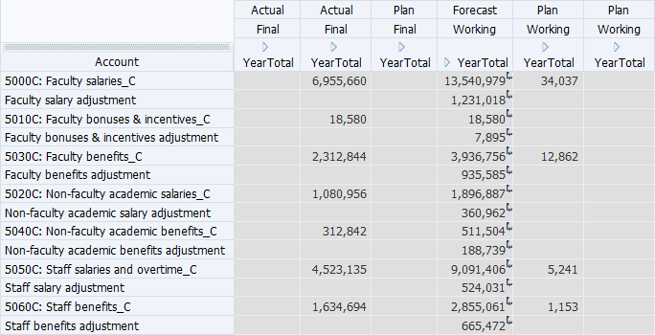
The Revenue and Expense form includes 7 salary and benefit adjustment accounts
The Revenue & Expense form includes 14 accounts related to salary and benefit expenses
7 read-only, numbered accounts that pull data from Employee Planning
7 writable, non-numbered accounts that allow salary or benefit adjustments by DFP

