Slide 1
UPlan General Planning
Budget & Resource Management
Spring 2024

Slide 2
© [2023-2024] “University of California San Francisco (UCSF)”
Ownership of Copyright
The copyright in this material (including without limitation the text, artwork, photographs, and images) are owned by UCSF.
Copyright License
UCSF grants to you a non-exclusive royalty-free revocable license to:
- View this material on a computer
- Store this course in your cache or memory
- Print pages or material from this course for your own personal and non-commercial use.
All rights reserved.
Enforcement of Copyright
UCSF takes the protection of its copyright very seriously. If UCSF discovers that copyrighted materials have been used in contravention of the license above, UCSF may bring legal proceedings against you seeking monetary damages and an injunction to stop you from using the materials.

Slide 3
Contents
Overview of General Planning
Revenue and Expense Form
Page Filters
Columns
Rows
Seeding and Global Assumptions
General Planning Reports

Slide 4
Overview of General Planning

Slide 5
General Planning allows you to plan revenue and non-salary expenses
General Planning consists of three data entry forms:
Revenue & Expense – Level C (or E for FAS)
Tuition & Fee Revenue Calculator
Revenue & Non-Salary Expense Global Assumptions
General Planning allows you to:
Forecast and plan at Account Level C (Level E for FAS)
Make adjustments at an aggregated level for Employee planning

Slide 6
General Planning is pre-loaded with several data feeds
Actual data from PeopleSoft General Ledger
Planned commitments from the UPlan Commitment Tracking module
Summary salary and benefit data from the UPlan Employee Planning module

Slide 7
Revenue and Expense Form

Slide 8
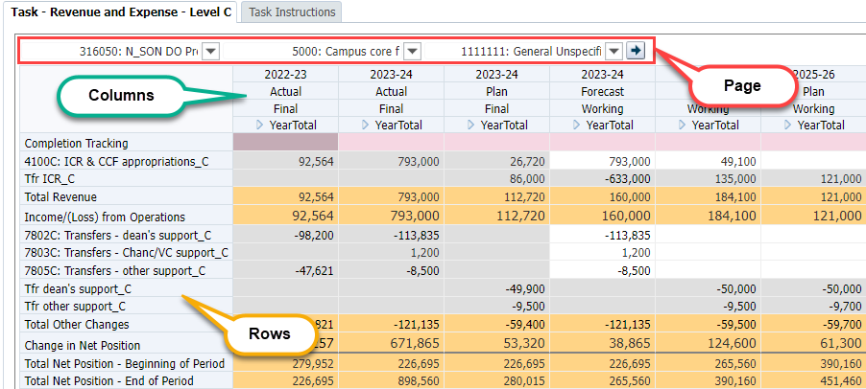
The Revenue & Expense Form is the primary data entry form
Page Filters: DeptID, Fund, and Project (DFP)
Columns: Year, Scenario, Version, and Period
Rows: Account
Notes:
We’ll talk about columns first, then rows then page filters in this lesson.
The primary General Planning form. This form resembles a P&L statement. There are two versions of this form. Most planners will use Revenue & Expense Level C form. FAS planners will use Revenue & Expense Level E form.
Page Filters: DeptID, Fund and Project (or DFP) combination
Columns: Year, Scenario, Version and Period
Rows: Account

Slide 9
Data can only be entered at a planning intersection of the DFP Page Filters
DeptID Planning levels are posting levels for all non-SOM units
Planning level for Fund is also the posting level
For project, currently
Select summary members for read only reviewing, such as “TotalFunds” or “TotalProjects” or Parent level DeptID.
Notes:
Note: To show dimension names in the Page Filter area, select View > Show Dimension Name on Page.
Users will have write access only to their assigned Planning DeptIDs.

Slide 10
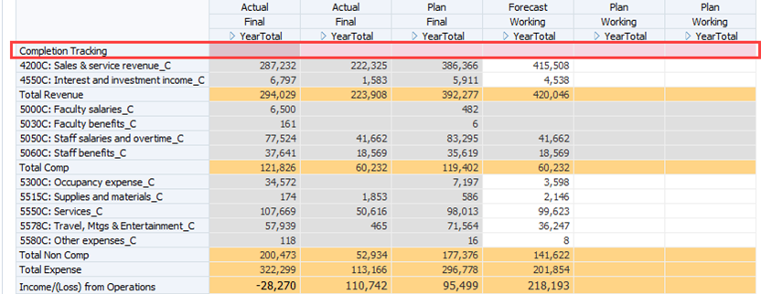
The Completion Tracking account helps planners track their progress
Notes:
Completion tracking helps you monitor progress.
This indicates your estimated percentage complete for the specific column
The number is entered by the planner – there is no other way to monitor status
The Completion Tracking row is colored pink for differentiation.
Enter amount in the YearTotal not the month.

Slide 11
Planning in UPlan is not always at the posting level of the DeptID tree
System access/security is based on DeptID
At a parent or planning level
Planning DeptIDs are chosen by individual departments
Managed via “Planning” attribute for DeptID in PeopleSoft
You cannot edit forecasts and plans for DeptIDs above (or below) your Planning DeptIDs
Note: only SOM has planning at a level higher than the posting level

Slide 12
UPlan allows flexibility in planning by project
1. Plan at the individual project level by using Account Detail by DFP:
Review data in Working version at higher than planning-level DFP (i.e. Department-level-Total Funds-Sponsored Projects)
If accurate enough, right-click on account > Account Detail by DFP > plan for individual projects
2. Plan at the aggregate project use level:
Same as #1 but use aggregate ADJ Project instead (i.e. 2011364: ADJ Sponsored)
Use Drill Through Actual Final Reports

Slide 13
UPlan-only ADJ Projects
Project ID | Project Description | Project Use | Purpose
2011364 | ADJ Sponsored | SPONSORED_PROJ | Adjustment projects, used in general planning and employee planning to plan additional sponsored activity not covered by Faculty Portfolio (FP). Not used in Commitment Tracking.
2011367 | ADJ Recruitment | RECRUIT_FAC_STARTUP | Adjustment projects, used in all spaces to plan additional activity not covered by an existing project. May also be used to avoid planning at the project level.
2011377 | ADJ Other Faculty/PI* | FAC_PI_OWNER_ACTV
2011379 | ADJ Retention | RETENTION
9002614 | ADJ Capital | CAP_PLANT
2011374 | ADJ General | GENERAL
2011375 | ADJ Affiliations | AFF_AGREE_CON
2011376 | ADJ Pgm Investments | PROG_INVESTMT
2011378 | ADJ MC Activities | MED_CTR_ACTV
6000468 | ADJ Loan | LOAN_STU_FAC_STAFF
8001131 | ADJ Recharges | RECHARGE
8500020 | ADJ Recharges External | RECHARGE_EXT
8800131 | ADJ Costed Central | COSTED_CEN_ACTV
*Note: This project refers to Other Faculty/PI Owner Activity, and is abbreviated in UPlan.
Notes:
. The DFP combination determines what data you are viewing, and where you are entering or editing data.

Slide 14
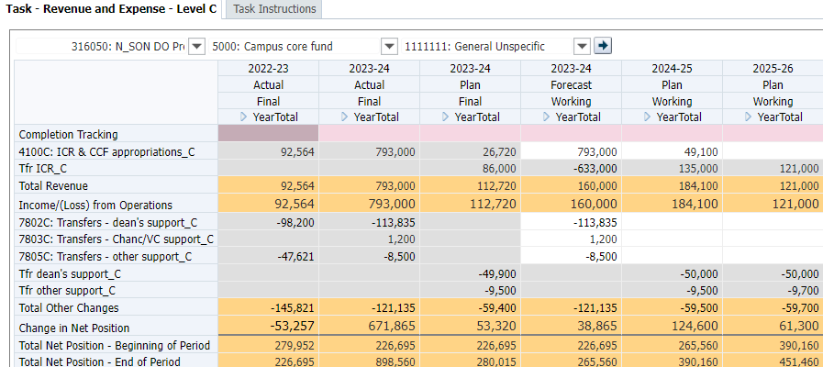
Columns on the Revenue & Expense form identify Year, Scenario, Version and Period
Column 1: Prior Year – Final Actuals
Column 2: Current Year – Final Actuals
Column 3: Current Year – Final Plan
Column 4: Current Year – Working Forecast
Column 5: Next Fiscal Year (Year 1) – Working Plan
Column 6: Subsequent Fiscal Year (Year 2) – Working Plan
Notes:
Column 1: 2022-2023 Actual Final – Prior Year
In Spring 2024, Column 1 will include Actual 2022-23 data.
Column 2: 2023-24 Actual Final – Current Year
6-8 months of Actual data as the months close. The rest of the open months will be blank and not writable.
Column 3: 2023-24 Plan Final – Current Year
The second column will contain Plan data for the current year, which is based on last year’s plan.
Column 3: 2023-24 Forecast Working – Current Year
Column 3 contains the latest forecast data. This will be updated based on the current calendar month. Any forecast data is paired with any closed Actuals data. This is the forecast you will update in Assignment #1 and #2.
Column 5: 2024-25 Plan – Year 1
Column 4 will hold the working version of Year 1 Plan. Initially, this will be blank (except for transfers pre-loaded in the Commitments Tracking module) and ready for seeding and or data entry. After you complete Assignments #1 and #2, as part of Assignment #3, the UPlan administrator will seed this plan with the 2023-24 Q3 Forecast. You will then make any adjustments for the 2024-25 Plan.
Column 6: 2025-26 Plan – Year 2
Column 5 will hold the Working version of Year 2 Plan. Once planners have updated their 2024-25 Plans and Level 1 and Level 2 Coordinators have adjusted global assumptions for Year 2, planners may seed Year 2 (2025-26) on their own. This activity will be discussed in Class #3.

Slide 15
The rows on the Revenue & Expense Form are Accounts
Grouped similarly to a P&L statement
Revenues
Expenses
Other Changes
Most planning occurs at COA Level C
FAS-only form offers COA Level E
UPlan-only accounts assist with planning
Unused rows are suppressed
Only rows with non-zero data appear, unless added by the user
Notes:
Since UPlan contains General Ledger actuals and FP data, most of the accounts you use for a particular DFP combination will display initially. However, you may need to add accounts. (See the Adding Accounts section for more information.)
Rows in this form are Accounts
Accounts are grouped similar to an income statement: Revenue, Expenses, and Other Changes
Most planners will plan at COA Account Level C
FAS planners will use a version at Account Level E
UPlan includes a number of UPlan-only accounts to assist with planning
“Row suppression” formats the Revenue & Expense form so only the rows with non-zero data will appear

Slide 16
Completion Tracking values should be entered in the YearTotal column
As you complete work on a specific DFP, type the percent completed in the YearTotal cell
Format: a number followed by a percent sign or a decimal representing that percentage.
Complete: 100% or 1.0
Partially complete: estimate your level of completion (example: 50% or .50 for half complete)
Notes:
To enter completion tracking information for a DFP combination:
Type the percent completed in the Year Total cell. Make sure to type a number followed by a percent sign or a decimal representing that percentage. Only enter in the YearTotal cell; this is data that will be reported on Completion Tracking Report
If you are complete with all planning (or forecasting) for this DFP combination, use 100% or 1.0.
If you are partially complete with your planning or forecasting for this DFP combination, type a percentage or decimal value representing your estimated percent complete (such as 50% or .50 for half complete.)

Slide 17
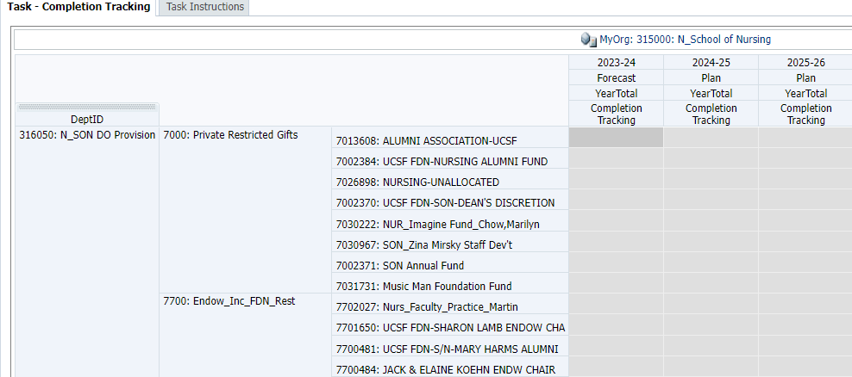
The Completion Tracking form report summarizes your progress
Shows all combinations of DeptID, Fund and Project within the MyOrg value where data currently exists
Right-click on project allows you to go to the Revenue and Expense form for a chosen DFP
Notes:
All combinations with non-zero Plan and/or Actual data

Slide 18
Use the Completion Tracking report to identify the DFPs you have not updated
Use the report to find appropriate DFP combinations to view, input, and modify your forecasts and plans.
You can export to Excel and search
The report is not an exhaustive list; there may be other DFP combinations that presently have no data but which you will use in the future
Found in General Planning > Reports
Use MyOrg to change the DeptIDs being reported
Notes:
You can export to Excel and search: NOTE: You will see extra columns in Excel due to hidden columns

Slide 19
A business rule allows you to reset your Completion Tracking values to zero
The rule is found in the General Planning folder
To run the rule, click on ResetCompletionTracking and hit Launch
The rule will prompt you to identify the Scenario, Year, and DeptID under which values should be cleared
Select an individual planning DeptID or a higher level DeptID to clear values for all of your DeptIDs
Repeat the rule as needed to clear other years, scenarios or DeptIDs
The UPlan Team runs this rule once during year-end maintenance in August
Notes:
Completion tracking helps you monitor progress.
This indicates your estimated percentage complete for the specific column
The number is entered by the planner – there is no other way to monitor status
The Completion Tracking row is colored pink for differentiation.

Slide 20
Certain revenue accounts are automatically populated
Account 4300C is fed from Tuition and Fee Revenue calculator form
Notes:
Revenue accounts relate to where you anticipate receiving funds. In most cases, you will only have data for one or two revenue accounts for a given DFP combination.
Typically, when you open the Revenue & Expense form and select your DFP settings, you will see one revenue account with data in Actual and Forecast columns. You may possibly see data in the current year Plan. You can update data for this account in Forecast or 2023-24 Plan. If you need to add another revenue account, use the right click menu and select Add account.
Two revenue accounts are always read-only on the Revenue & Expense form:
Revenue from Student tuition and fees (account 4300C) will be calculated and fed based on data entered on the Tuition & Fee Revenue Calculator Form. Use the Tuition & Fee Revenue Calculator Form to enter this data.
Sponsored project revenue (account 4500C). This account will auto-balance with total Sponsored project expenses.

Slide 21
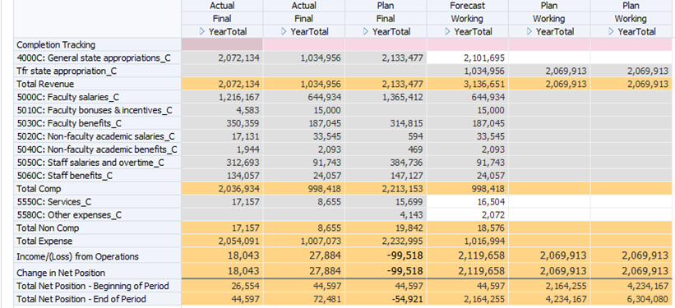
Numbered salary and benefit account values are fed from Employee Planning
Salary and benefit accounts fed from Employee Planning
Notes:
Expense account rows show your expenditures of funds. For a given DFP combination, you will see rows for expenses previously recorded in actuals, the 2023-24 Plan, and the current Working Forecast.
If you need to plan additional expenses, you can right click and add accounts to find them.
Several expense accounts are always read-only on the Revenue & Expense form. These are the salary and benefit accounts that are fed from the Employee Planning module. As mentioned below, there are several UPlan-only salary and benefit accounts that can be used to make adjustments on the Revenue & Expense form.

Slide 22
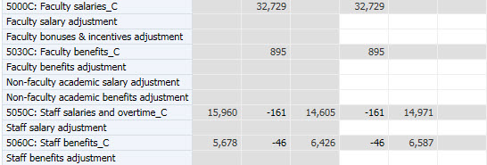
Salary and benefit adjustment accounts allow planning at the DFP level
Unlike salary and benefits accounts fed from the Employee Planning module, these are writable.
These accounts allow adjustments to their salary and benefit expense plans at a DFP level, rather than at an employee level.
Notes:
The first is a set of seven salary and benefit adjustment accounts. These can be identified on the Revenue & Expense form in the Expense account section: unlike the salary and benefit accounts fed from the Employee Planning module, they are writable for the working forecast and plan scenarios and they are not numbered. These accounts are available to help planners make adjustments to their salary and benefit expense plans at a DFP level, rather than at an employee level. This is particularly useful for the Year 2 plan, since the Employee Planning module does not support employee-level planning for Year 2. No actuals will appear in these account rows and when final forecasts and plans are sent to the data warehouse and MyReports, the values in these adjustment accounts are added to the corresponding numbered Level C or Level E accounts. These accounts will be covered again in Employee Planning section.

Slide 23
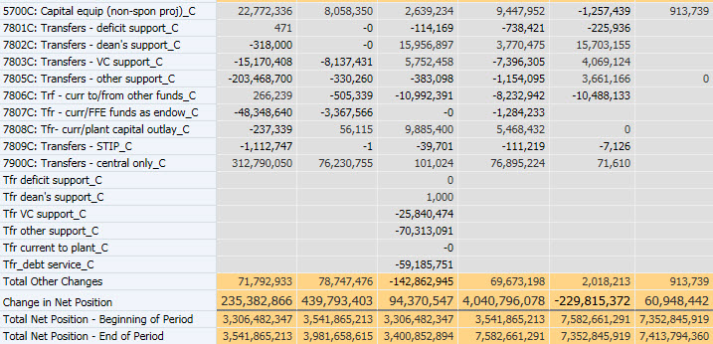
No special accounts exist in the Other Changes section
Notes:
The Other Changes section captures account activity that is considered “non-operating”. Included here are capital equipment expenditures for non-sponsored activity, and a range of transfers, including dean and vice chancellor support transfers, transfers to plant and transfers to FFEs. All of the Other Changes rows are writable for the forecast and plan scenarios.

Slide 24
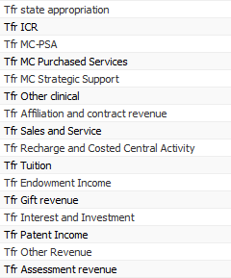
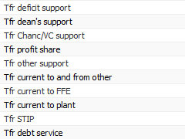
UPlan-only Tfr Accounts capture transfers planned in Commitment Tracking
Other Changes
Tfr Accounts
Revenue Tfr Accounts
Expense Tfr Account
Notes:
These accounts appear in all three sections of the Revenue & Expense form (Revenues, Expenses, and Other Changes) and begin with “Tfr” instead of a number. These accounts are read-only on the Revenue & Expense form.
Transfers of funds from within the campus should be planned in the Commitment Tracking module. For example, State funding allocations from the Chancellor will be planned using the Commitment Tracking module. Transfers planned in that module that have an approval date will be fed to General Planning. The transfer will appear on the Revenue & Expense form as a transfer out (negative amount) for the Source DeptID and as a transfer in (positive amount) for the Target DeptID. For both the Source and Target, the transfer will appear on the Revenue & Expense form on a Tfr account. Other transfers similarly planned in the Commitment Tracking module will also appear on Tfr account rows on the Revenue & Expense form.
When you are expecting a transfer, remember to communicate with the other department and decide who is going to enter it. If the Source DeptID is going to enter this as a commitment to your DeptID in CommtPln, then it will flow to the appropriate Tfr account. In this case, you would not enter it as part of your revenue forecast or plan so as to prevent double-counting. If the Source DeptID chooses not to enter a “Commitment,” then simply plan for the estimated revenue in the appropriate revenue account
Revenue Tfr Accounts capture transfers of funds where the transfer is akin to the normal revenue a unit might “earn” for its operations. Revenue transfers are transfers you would consider to be “earned” as part of your operations. For example, recurring State funds allocations may be considered earned, since the State is paying the unit to operate an instructional program. For example, recurring allocations of State funds will appear in the revenue section, since that support is provided in recognition for the mission of the unit.
Only one Expense Tfr Account is used. It captures the expense side of a planned assessment transfer.
Other Changes Tfr Accounts capture planned non-operating transfers. In some cases, these transfers are akin to subsidies. They might come from the dean or the vice chancellor for non-operating activities. Other examples of Other Changes are transfers for debt service, plant, or transfers to or from a fund functioning as an endowment (FFE). These non-operating transfers appear “below the line,” meaning below the Total Income/ (Loss) from Operations line. They roll up to account 5700C or 5700E. Other Changes will be included in your Change in Net Position calculation. (See the Calculated Rows section for more information.)

Slide 25
Several rows are calculated
Row | Calculation
Total Revenues | All Revenue Accounts + Operating Transfer (Tfr) Accounts
Total Expenses | Expenses + Tfr Assessment Expense
Income/(Loss) from Operations | Total Revenues – Total Expenses
Other Changes | Non-operating transfer (Tfr) accounts + Other Changes accounts
Change in Net Position | Total Revenues – Total Expenses + Other Changes
Total Net Position–End of Period | Total Net Position – Beginning of Period + Change in Net Position

Slide 26
Net Position accounts
Net position represents a positive or negative balance
Change in Net Position: change in your planned DFP balance over a period of time
Net Position – Beginning of Period: your net position at the start of a particularly period
Net Position – End of Period: your net position at the end of a particular period
Net Position – End of Period for a particular month | = | Net Position – Beginning of Period for subsequent month
Notes:
In the new COA, Net Position as a concept replaces the concept of the unexpended balance. Your net position represents your positive or negative balance. There are three rows related to Net Position.
In UPlan, Change in Net Position represents the change in your planned DFP balance over a period of time. For example, the Change in Net Position for August equals your Total Revenues for August minus your Total Expenses for August, plus your Total Other Changes for August. Change in Net Position can be similarly calculated for a quarter or year.
Net Position – Beginning of Period represents your net position at the start of a particularly period. So each month will have a Net Position ––Beginning of Period. The Net Position – beginning of Period for a fiscal year is equal to the Net Position – Beginning of Period for July.
Net Position – End of Period represents your net position at the end of a particular period. It is calculated as the sum of the Net Position – Beginning of Period plus the Change in Net Position. Similar to Net Position – Beginning of Period, each month has a Net Position – End of Period, and the Net Position – End of Period for the fiscal year is the same as the Net Position – End of Period for June.
Note also that the Net Position – Beginning of Period for a particular month is equal to the . Thus, as you build your plans or forecasts, the Net Position – End of Period amount is calculated for each month and carried forward as the Net Position – Beginning of Period amount for each subsequent month.

Slide 27
Seeding and Global Assumptions

Slide 28
What is Seeding?
Seeding starts the working version of a scenario using data from another scenario and version, for example:
When the UPlan Administrator takes Plan Final data and copies it into the Forecast
When planners seed their Year 2 plans after adjusting their Year 1 plans
Seeding involves launching a business rule in UPlan
Notes:
As mentioned above, seeding describes how data is moved into a scenario to kick-start the working version of that scenario.
The next time data is seeded is when a control point coordinator takes 2024-25 Forecast and moves it into the 2025-26 Plan. The timing of this is important. Seeding will occur after Planners have made revisions to their FY25 Forecast and after Coordinators have entered global assumptions for 2025-26.
Finally, after adjusting their FY26 plans, planners will seed their FY27 plans.
When users perform the task of seeding, they are using something called a business rule. There are many business rules behind the scenes in UPlan, but seeding is a task you will launch at the appropriate time.

Slide 29
What are Global Assumptions?
A percentage increase or decrease applied to a group of values when seeding a new fiscal year planning scenario
In General Planning, applied to revenue and expense accounts
In Employee Planning, applied to salary levels by Union Code
Used to reduce planning workload
Enables focus only on critical adjustments at the employee or DFP level
Notes:
Global assumptions are percentages that each Control Point can set to increase or decrease plans from one year to the next. Level 1 and Level 2 coordinators can input percentage increases or decreases for specific categories of Funds and Project Uses for General Planning and for Title Unit Codes for Employee Planning.
For 2016-17, values in the FY15 Forecast will be multiplied by (1 + global assumption percentage). Global assumptions will not apply in certain cases, so the global assumption in those cases is zero. In those cases, the Forecast value is just carried forward to the FY17 Plan. For the FY18 Plan, the global assumptions are applied to the FY17 Plan.
To reduce your planning workload, you can maximize the use of global assumptions and focus only on critical adjustments at the employee or DFP level. How much fine-tuning you do for your planning is up to you and your Control Point.
There are some differences in how global assumptions work in the different UPlan modules. We will go over these differences in the next section.

Slide 30
Global assumptions may be applied when a future year Plan is seeded
For example:
The Year 1 Plan may be seeded with values in the Year 0 Forecast, adjusted by the global assumption
The Year 2 Plan may be seeded with Year 1 Plan data plus global assumptions
After seeding, planners may manually adjust values as needed

Slide 31
Setting Global Assumptions
Control Points set Global Assumptions to increase or decrease accounts in plans from one year to the next
Some Global assumptions may be set at zero (i.e., not applied)
Level 1 Coordinators set global assumptions by Fund and Project Use for Control Point
Level 2 Coordinators can adjust for their departments
Notes:
In General Planning, Level 1 Coordinators can set global assumptions by Fund and Project Use for their control point. Level 2 Coordinators can adjust these for their departments. Coordinators enter a negative or positive percentage that maps to a group of funds and project uses.
Global assumptions can be applied when a Plan is seeded. If you choose to use global assumptions, during seeding, global assumptions will be applied to the baseline seeded working version of a Plan, by Fund/Project Use and Year. After Plan seeding, planners may manually override specific dollar amounts on the General Planning Revenue & Expense form.
In Employee Planning, Level 1 and 2 Coordinators can set global assumptions by Title Unit Code for their control points and departments. In Year 1 (2023-24 Plan), the percentages apply to base salary only. Seeding is automatic, and these percent increases (or decreases) will be part of the Working version of the Plan. The Override Global % field on the Adjust Salary Data Entry Forms gives planners a mechanism to supersede the global assumptions. When you enter a value in Override Global % for an existing employee, it will apply this new increase or decrease to the original base salary even after it was seeded and global assumptions were applied to it.
In Year 2 (2017-18), global assumptions will apply to all salary components (base salary, negotiated salary, Faculty Bonuses/Incentives and Additional/Other Salary). Planners cannot adjust Year 2 plan data at an individual employee level. Beyond global assumptions, planners must use salary and benefit adjustment accounts in General Planning to make changes for these expense categories for Year 2.
In Commitment Tracking, there are no global assumptions. Seeding is performed by the UPlan Administrator.
The following sections give further details on global assumptions and seeding for the General Planning and Employee Planning modules.

Slide 32
Seeding Process and Global Assumptions:
Before seeding | Planner updates current year forecast General Planning: Coordinator updates global assumptions Employee Planning: Planner updates global assumptions
During seeding | General Planning: Planner choose to seed with or without global assumptions
After seeding | General Planning: Adjust specific DFPs at the Account level Employee Planning: Make adjustments for specific employees Employee Planning: Create/adjust to-be-hired provisions
Update
Current Year Forecast
Update
Year 1
Global Assumptions
Run Business Rule to Seed Year 1 Plan
Adjust
Year 1 Plan
Update
Year 2
Global Assumptions
Run Business Rule to Seed Year 2 Plan
Adjust
Year 2 Plan
(General Planning Only)

Slide 33
Coordinators have special responsibilities in General Planning
Role | Actions
Level 1 Coordinator | Set global assumptions. When saved, UPlan copies these to all DeptIDs within the Control Point
Level 2 Coordinator | Adjust Control Point’s global assumptions. When saved, UPlan copies these to all DeptIDs within the department.
Planner | Manually adjust plans for individual DeptID/Fund/Project combinations at the Account level, thereby overriding global assumptions for Year 1. Seed Future Year 2 with or without global assumptions by running the seeding business rule. Manually adjust plans for individual DeptID/Fund/Project combinations at the Account level, thereby overriding global assumptions for Year 2.
Notes:
Generally, planners will review global assumptions for revenue and non-salary expenses and decide when and how to seed plans. However, for the 2024-25 Plan, Control Point Coordinators will perform seeding.

Slide 34
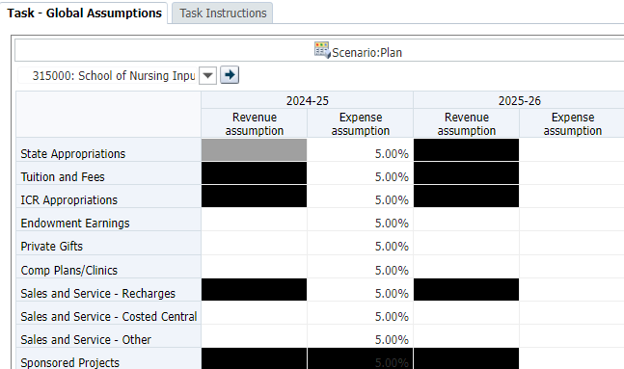
Planners should review the global assumptions for their DeptID
Go to General Planning > Seeding and Global Assumptions > Global Assumptions
Notes:
Coordinators use the Revenue and Non-Salary Expenses Global Assumptions form to enter percentages for their Control Point or Department by Fund/Project Use. They can enter percentages for Year 1 and Year 2.
Global assumptions will not apply to certain categories, as indicated by the blacked out cells. Thus, the form supports you in entering data only into the appropriate intersections. For example, you cannot enter an assumption percentage for ICR Appropriations Revenue (because these transfers are planned in the Commitment Tracking module), but you can enter an assumption percentage for ICR Appropriations Expense.
In most cases, the global assumption applies to all projects within a Fund.
For example, the global assumption for Private Gift funds would apply to all projects funded from this source.
For Sales and Service funds, the global assumptions are split for different project uses: Recharges, Costed Central Activities, and all other projects.
Global assumptions will apply only to certain revenue and expense accounts. Certain accounts were excluded from the application of global assumptions because plans for these revenue and expense categories are more volatile, such as capital equipment expenses, and global assumptions are inappropriate. For these revenue and expense accounts, planners will need to make manual adjustments. A Quick Reference Guide provides a table showing the application of global assumptions by revenue and expense account.
Note: The black cells in the Revenue & Non Salary expense should not be used. These intersections do not need global assumptions applied, as they are handled via the Commitment Tracking module, another data entry form or Faculty Portfolio.

Slide 35
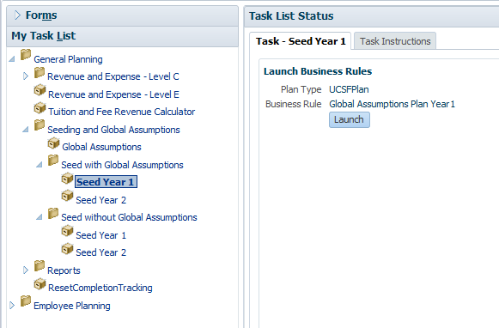
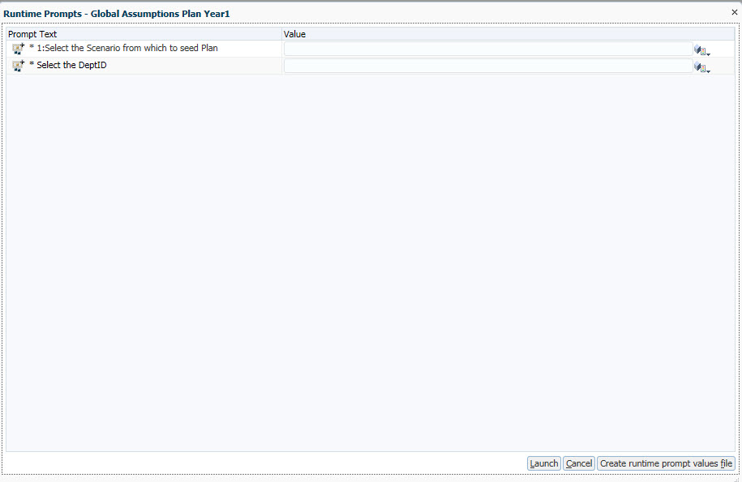
In General Planning, separate seeding rules apply to global assumptions
Planners may seed each year with or without using global assumptions
Launch the rule and select the DeptIDs to seed and the source of seeding
Notes:
Seeding for Multiple DeptIDs
Q: When seeding; if you have two Planning DeptIDs, can you choose to seed both at the same time?
A: You can seed your planning DeptIDs individually, or you can seed for a group of Planning DeptIDs by selecting a parent DeptID in the Member selection prompt. You cannot simultaneously seed two DeptIDs that do not share a common parent DeptID.

Slide 36
General Planning Reports

Slide 37
Several General Planning form reports are designed to help with planning
Report | Description
Completion Tracking | All DFP combinations with non-zero data within the MyOrg selection and their completion tracking values for a selected Year, Scenario, and Version
Plan Net Position | Summary revenue, expense, and net position values for all DFP combinations with non-zero data within the MyOrg selection for a selected Scenario/Version/Year
Tuition Revenue by Selected DFP | Enrollment and tuition revenue data across all years and scenarios for a selected DFP combination
Tuition Revenue by Selected Year and Scenario | Enrollment and tuition revenue data across all DFP combinations within the MyOrg selection for a selected Year, Scenario, and Version

Slide 38
The Plan Net Position report helps identify DFP combinations with planned deficits
Notes:
The Plan Net Position (formerly Plan Deficit) Report is intended to help identify planned negative ending balances. The report looks at DeptIDs under the designated MyOrg. Since, within General Planning, you plan by DFP Combinations, this report displays information by DFP combination. Page Filters allow you to change the Year, Scenario, and Version you are viewing. Columns include these UPlan calculated accounts:
Total Revenue
Total Expenses
Income (Loss) from Operations
Other Changes
Change in Net Position
Total Net Position – Beginning of Period
Total Net Position – End of Period
Similar to the Completion Tracking report, you will need to have set the MyOrg preference before running this report the first time.

Slide 39
Additional Net Position form reports help identify current year deficits
Report | Description
Net Position – Actual and Forecast by DFP | Current year actual and forecast net position data for all DFP combinations with non-zero data within the MyOrg selection
Net Position – Actual and Forecast by DeptID and Fund | Current year actual and forecast net position data for all DeptID-Fund combinations with non-zero data within the MyOrg selection for the selected Project
Net Position – Actual and Forecast by Fund | Current year actual and forecast net position data for all Funds with non-zero data within the MyOrg selection for the selected DeptID and Project

Slide 40
Hyperion Financial Reports (FR) provide P&L-style summaries of planning data
Found in HomePage > Explore button
Root > General Reports > Tfr Accounts Separated folder

Slide 41
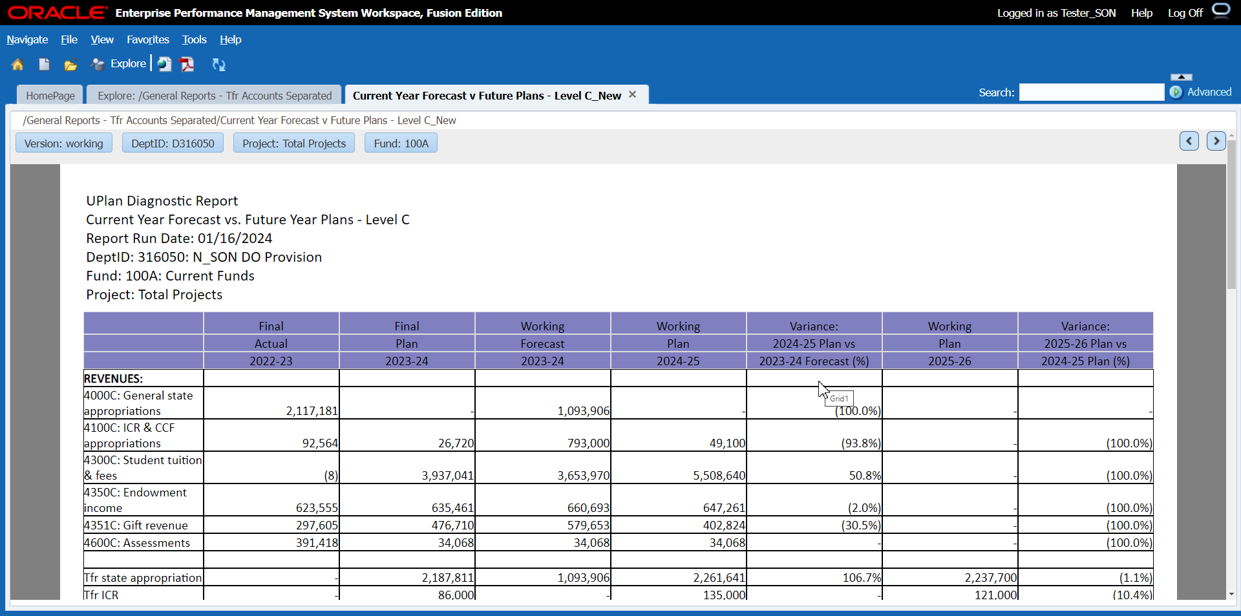
In these reports, rows are always accounts, but columns vary
Notes:
A special note about General Planning Variance Reports:
Values for the UPlan-only non-numbered salary and benefit adjustment accounts that appear on the Revenue & Expense form in General Planning are added to the regular numbered salary and benefit accounts in the General Planning Variance Reports. Thus you will not see the non-numbered adjustment accounts as rows in the reports.

Slide 42
QUIZ! 1. How are dimensions reflected in the Revenue and Expense Form?
Dimension | Check the appropriate location
 | Page Filter or POV | Row | Column
Fund
Version
DeptID
Account
Project
Period
Scenario
Year
Notes:
Answer:
Fund: Page
Version: Col
DeptID: Page
Account: Row
Project: Page
Period: Col
Scenario: Col
Year: Col

Slide 43
2. The Completion Tracking report can: (check one)
List all DFP combinations that have data
Automatically record the percent complete each time I enter my R&E form
List my new DFP combination if there is no data
Meet all my needs related to tracking my plans
Notes:
Answer: List all DFP combinations that have data

Slide 44
Answers to General Planning Quiz
Page Filters: DeptID, Fund, and Project
Columns: Year, Scenario, Version, and Period
Rows: Account
a

